Slide 1
The Final Software Project Power Point
Austin Brittenham
University of Arizona Global Campus
CST 499: Capstone for Computer Software Technology
Professor: Joseph Rangitsch
Due Date: 3/17/2025
Notes:
Hello, Class and Professor,
My name is Austin Brittenham, and I am a University of Arizona Global Campus student. This is my Final Software Project PowerPoint presentation for CST 499: Capstone for Computer Software Technology.
Today, I’m going to Discuss
Key Aspects of SRS Document
UML Use-Case Diagram
UML Activity Diagram
MySQL Database Tables
and
Pages within my database and the PHP code used.
NEXT PAGE:
Let's start by examining the key aspects of the SRS document!

Slide 2
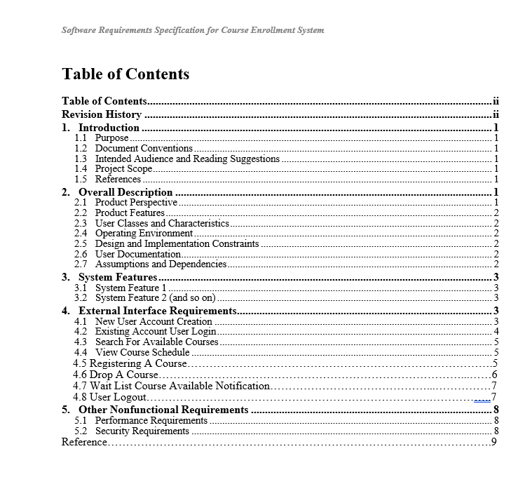
Key Aspects of SRS Document
5 Sections: Introduction, Overall Description, System Features, External Interface Requirements and Other Non-Functional Requirements.
Purpose and Scope
Provide an outline for a student enrollment system
Allow students to manage their course schedule through a self-service website
Allows Guest users to register a student account or view school-offered courses.
Allow Students to log in and out of their account, view their current schedule, search available courses, register for a course, be added to a waitlist if a class is full, or drop a course from their schedules.
Notes:
There are 5 Sections to this SRS document. They include
the Introduction
Overall Description
System Features
External Interface Requirements
And
Other Non-Functional Requirements.
The main purpose is to provide an outline for a student enrollment system that will allow students to manage their course schedule through a self-service website.
NEXT PAGE:
Up Next is My UML Design Models! Here, we will talk about how they will work together with the SRS Document.

Slide 3
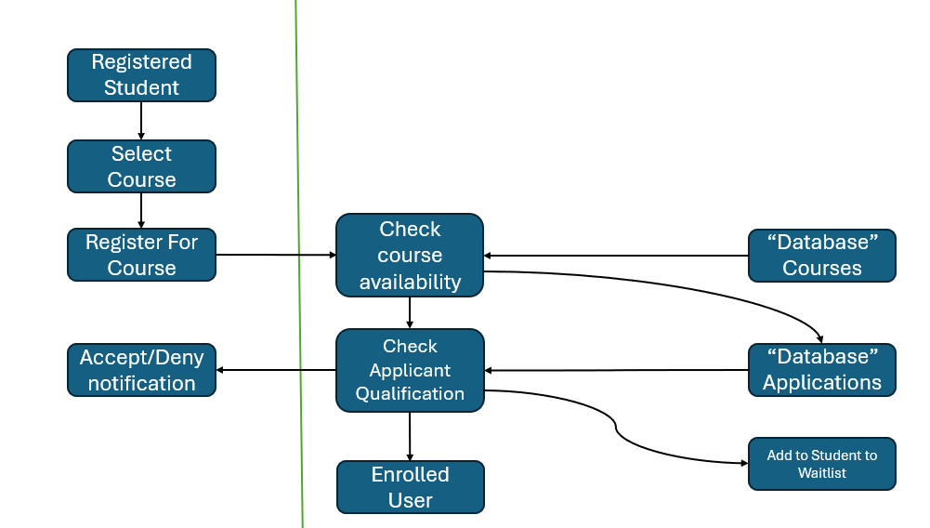
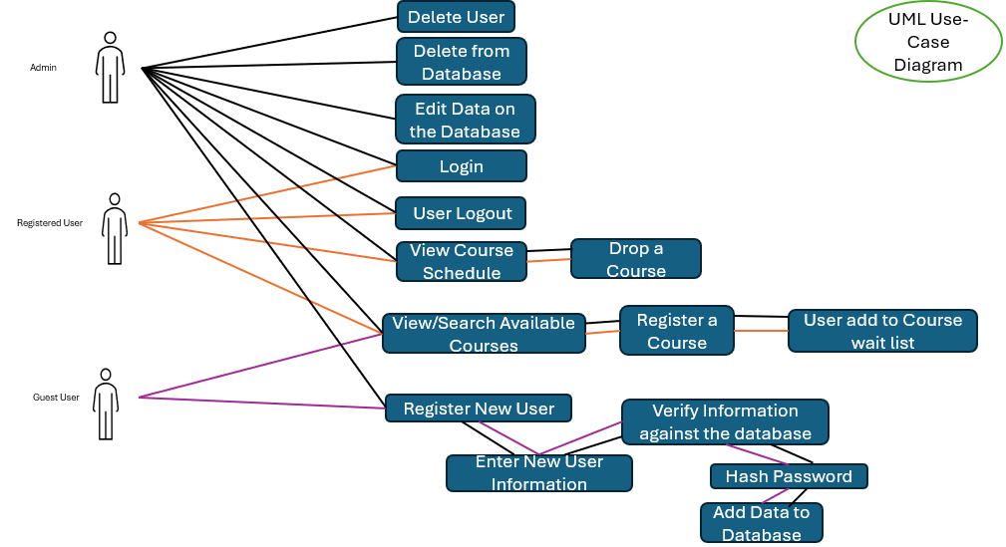
UML Design Model
Course Registration System
Notes:
The first diagram on the left is my UML Use-Case Diagram. It shows what function is allowed by the Admin, a Registered User, such as a student or a Guest User.
The Guest User can only
search or view Courses and
register as a New User.
If they choose to register as a new user, also known as a new student,
they will be prompted to enter their personal information, which will be verified against the database.
Once verified and confirmed
their password is hashed and
their information is saved in the database.
Once their information is saved to the database, the now Registered User or Student is assigned a Username.
The Register User, also known as the Student, can
log in
Log out
View the Course Schedule
Drop a Course
View or Search Available Courses
Register a course from the available course list and
be added to a waitlist if the class is already full.
The Admin can do everything a Registered User can do, as well as
Edit data on the Database by using the Website
deleting data and
deleting registered users from the database.
The Second Diagram on the right is my UML Activity Diagram showing the Course Registration System. This shows how a Registered User or Student can register for a course.
It starts with a
Registered Students select which course they want to enroll in and then select register.
It will search the database tables for course availability within the course database and check the applicant's qualifications.
Once done, it will Accept or Deny allowing the student into that class.
If accepted, the student will receive one of two popups
If the student is enrolled, a pop-up will inform them that they are enrolled.
If the Class is full, a pop-up will inform them that the class is full and redirect them to the waitlist registration to register the waitlist for that class.
NEXT PAGE:
The Next two Slides will talk about My SQL database Tables.

Slide 4
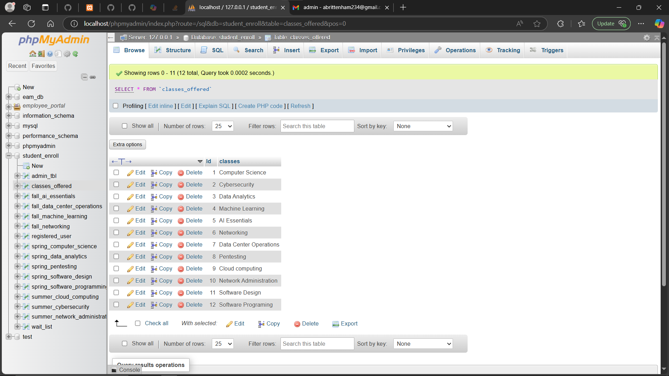
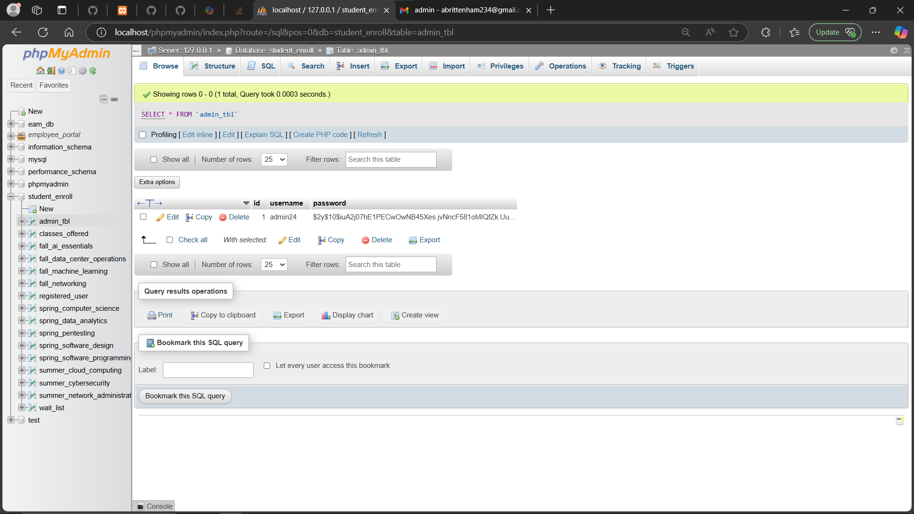
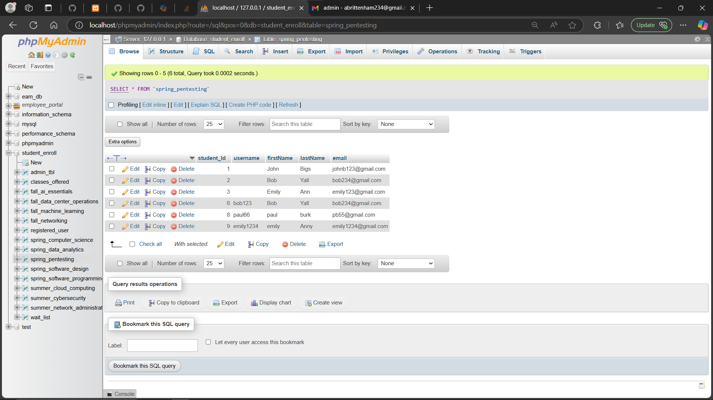
MySQL Database Tables
Classes offered at this university drop-down
Registered Admin Table
Pen Testing Students Registered Table
Notes:
These are just 3 of the many tables I used for My MYSQL Database.
The ones I included are the
Registered Admin table which is used
when a new admin needs to register as an admin
Classes offered at this university drop-down
which is located on the homepage for non-registered users to be able to see what classes are offered by this university
Pen Testing Student Registered Table
Which is one of classes offered by this university and this table just shows the students that are enrolled currently into this class
NEXT PAGE:
Up Next is 3 more tables within my MYSQL database.

Slide 5
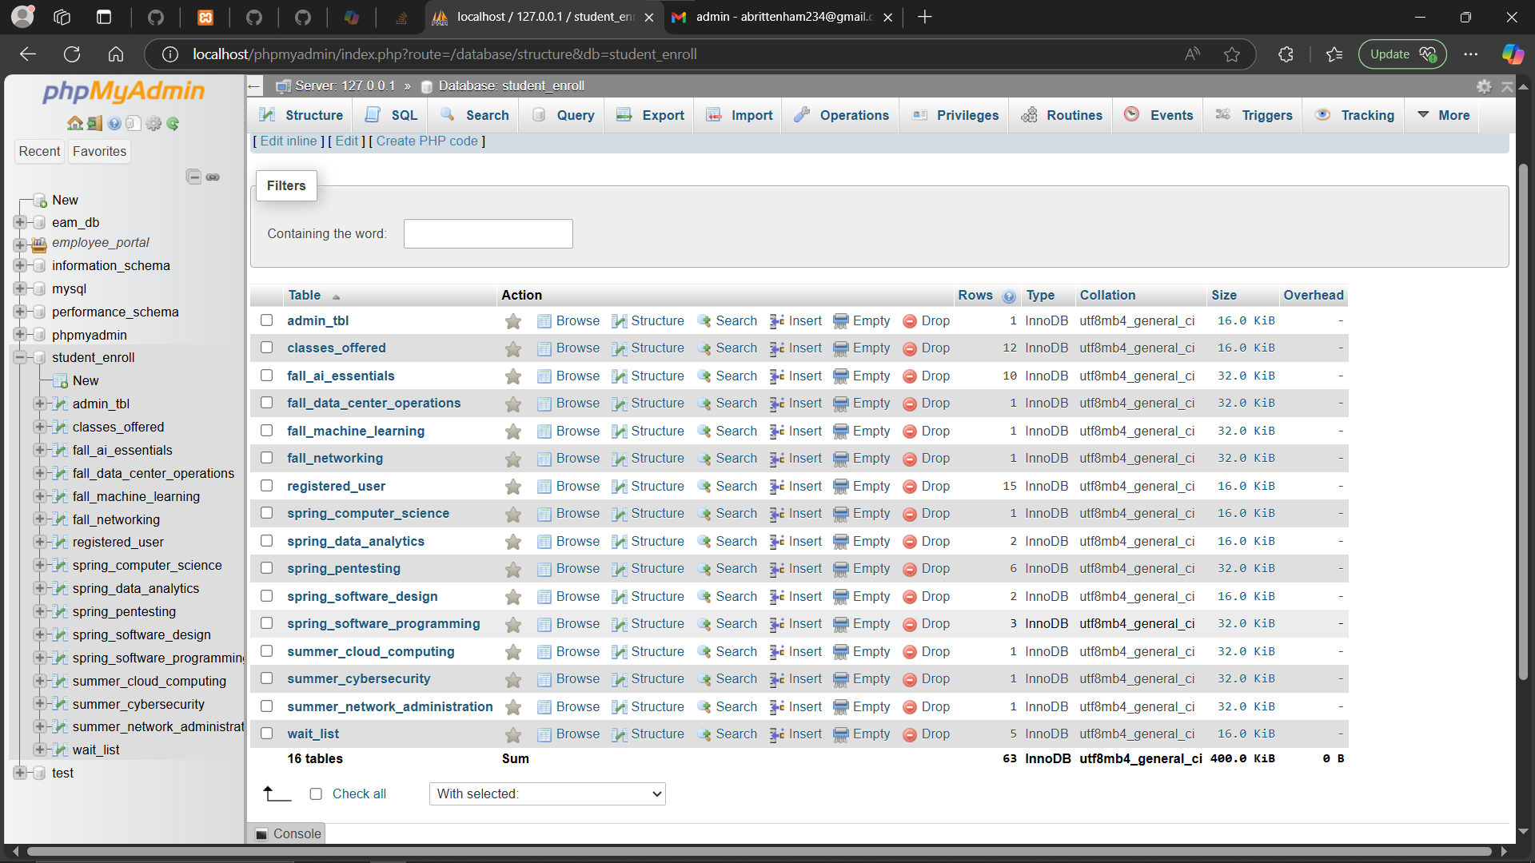
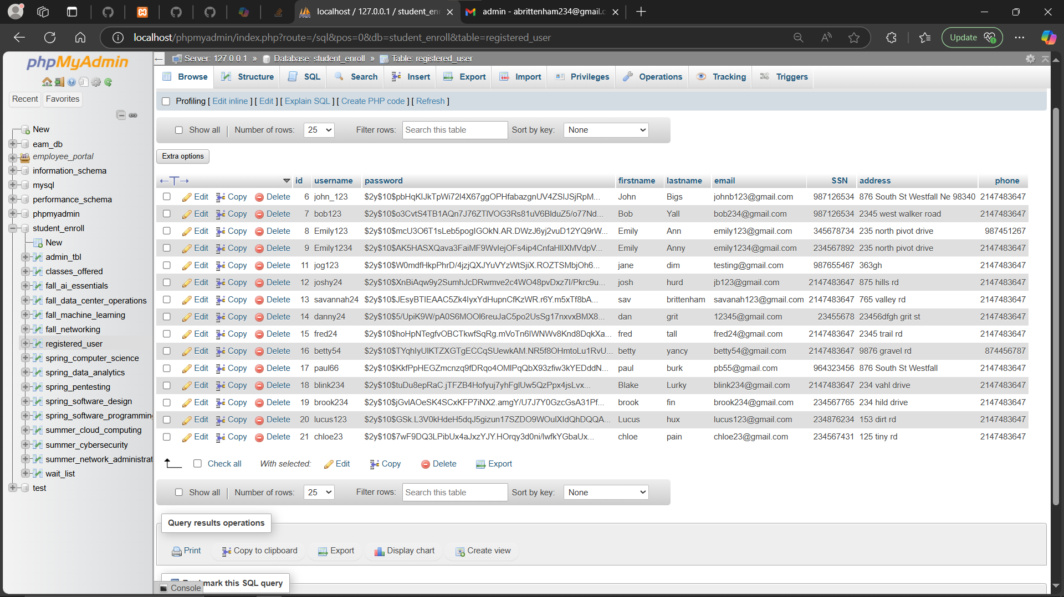
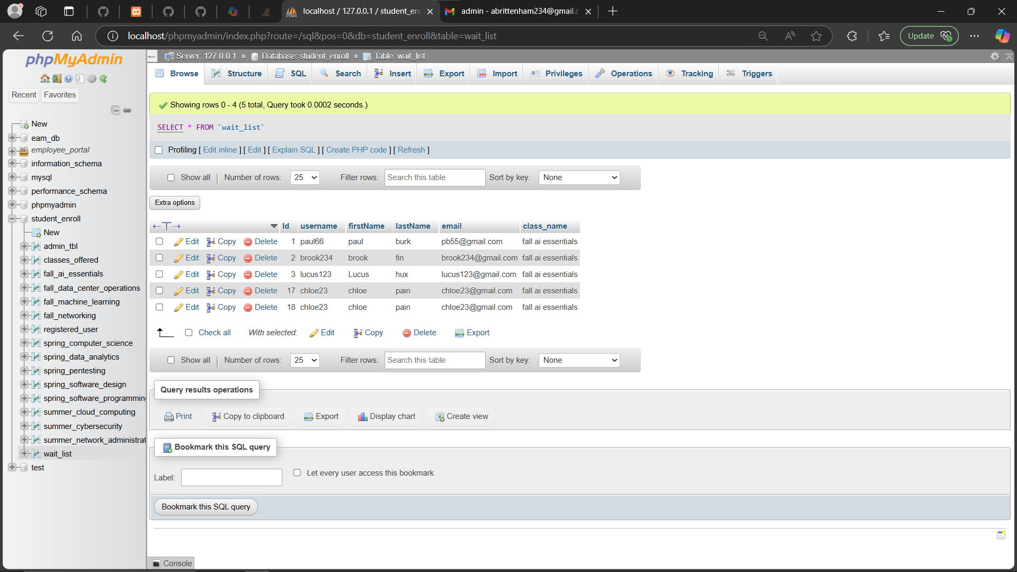
MySQL Database Tables
Student Enrolled Database with all Tables
Students Registered Table
Students Registered to a waitlist table
Notes:
These are 3 more tables I used for My MYSQL Database.
The ones I included are the
Student Registered table, which is used
To show all of the students enrolled on the university website
Student Enrolled Database with all tables
which is all of the tables within the database
Student Registered to a waitlist Table
This is a table that if a class is full and the student registers to be added to the waitlist for that class, this is the table it is stored in.
NEXT PAGE:
Up Next is six slides going into talking about different pages on the website and the PHP code used for each of these particular pages.

Slide 6
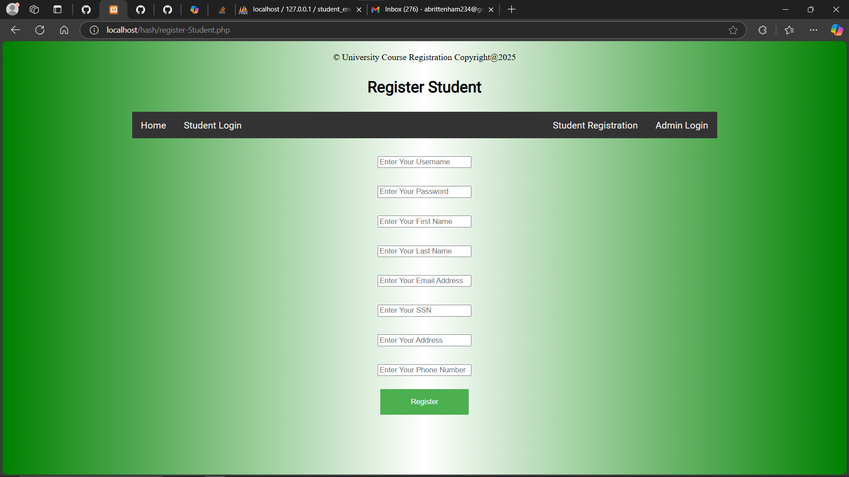
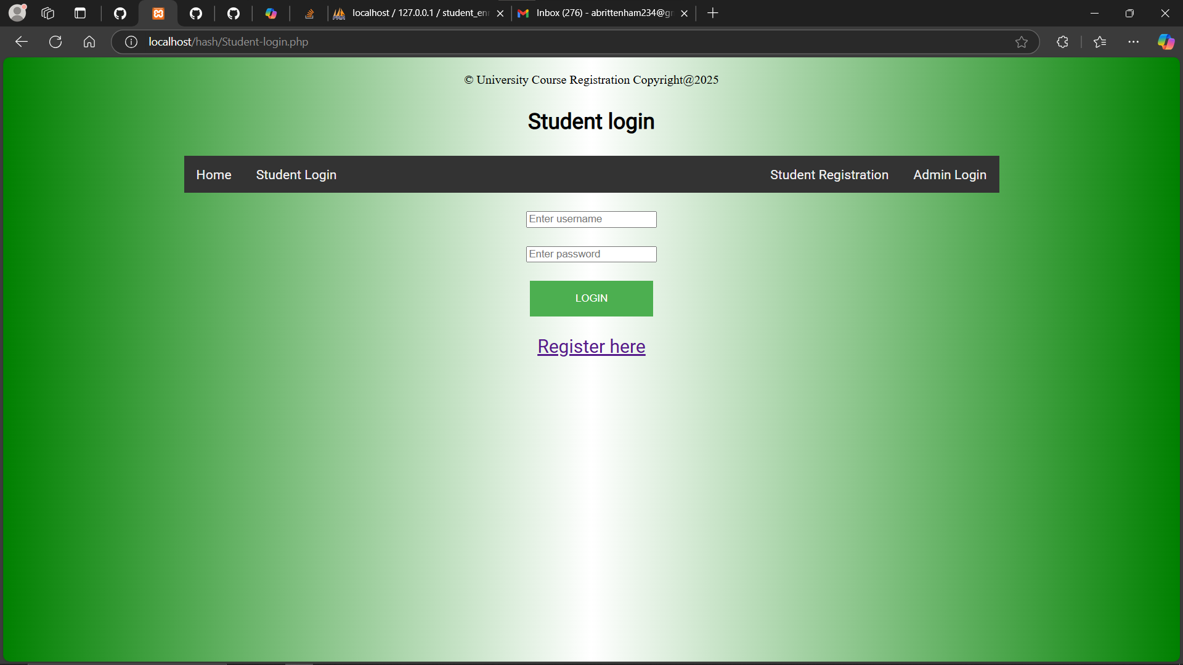
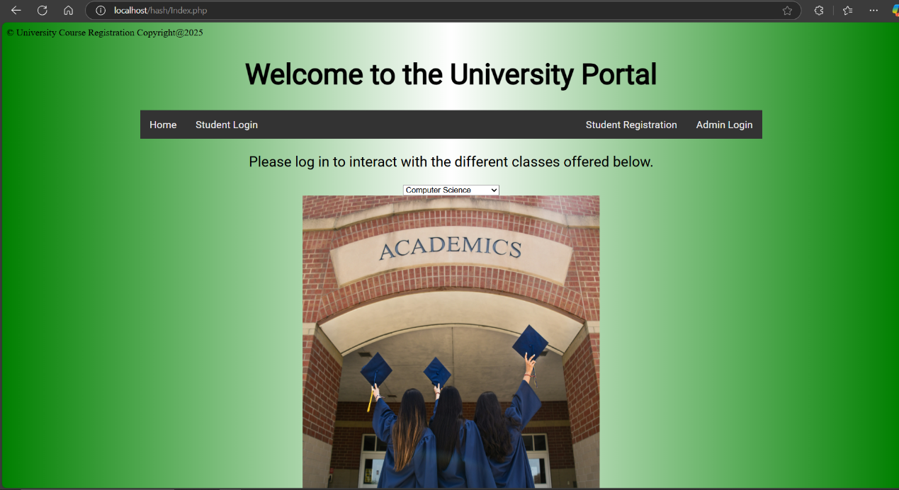
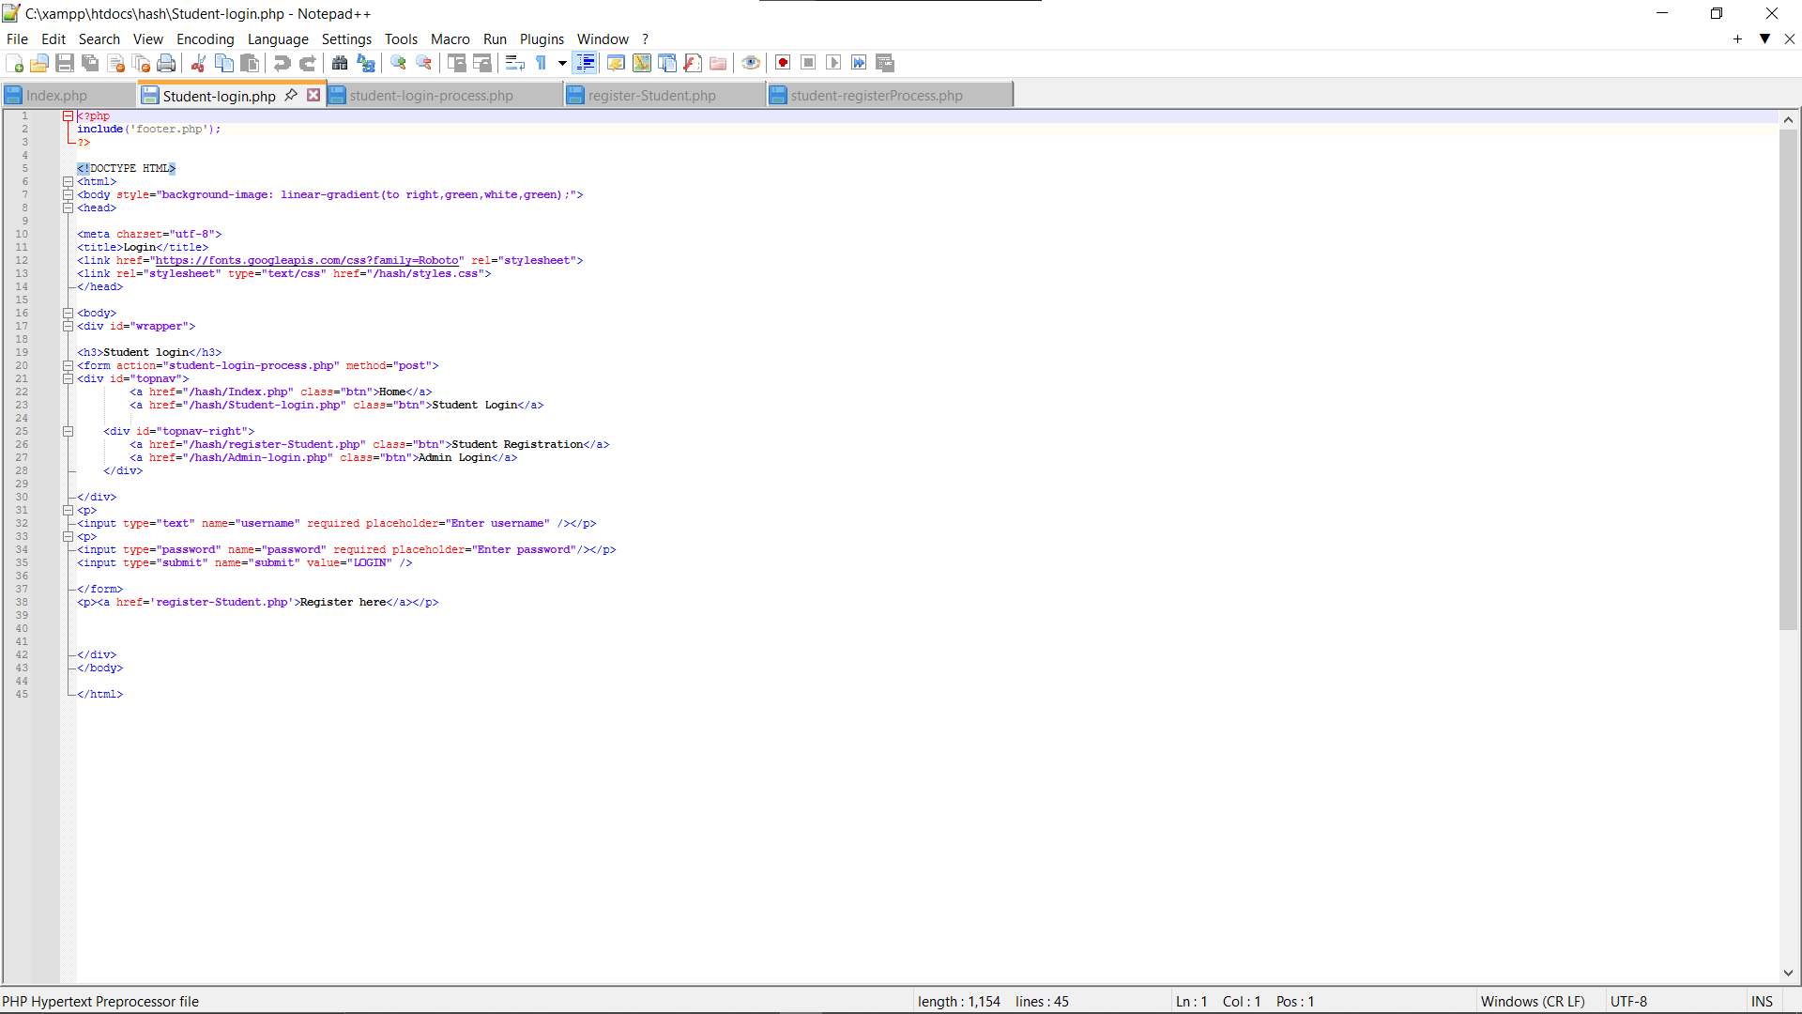
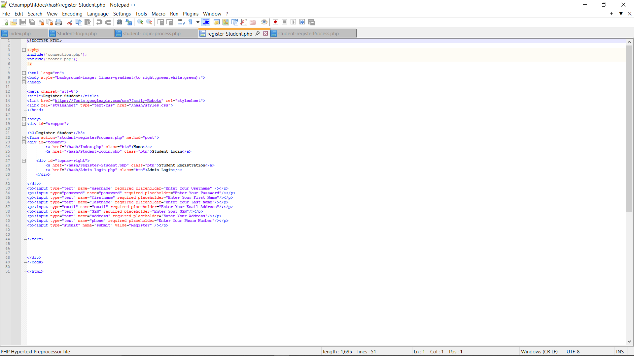
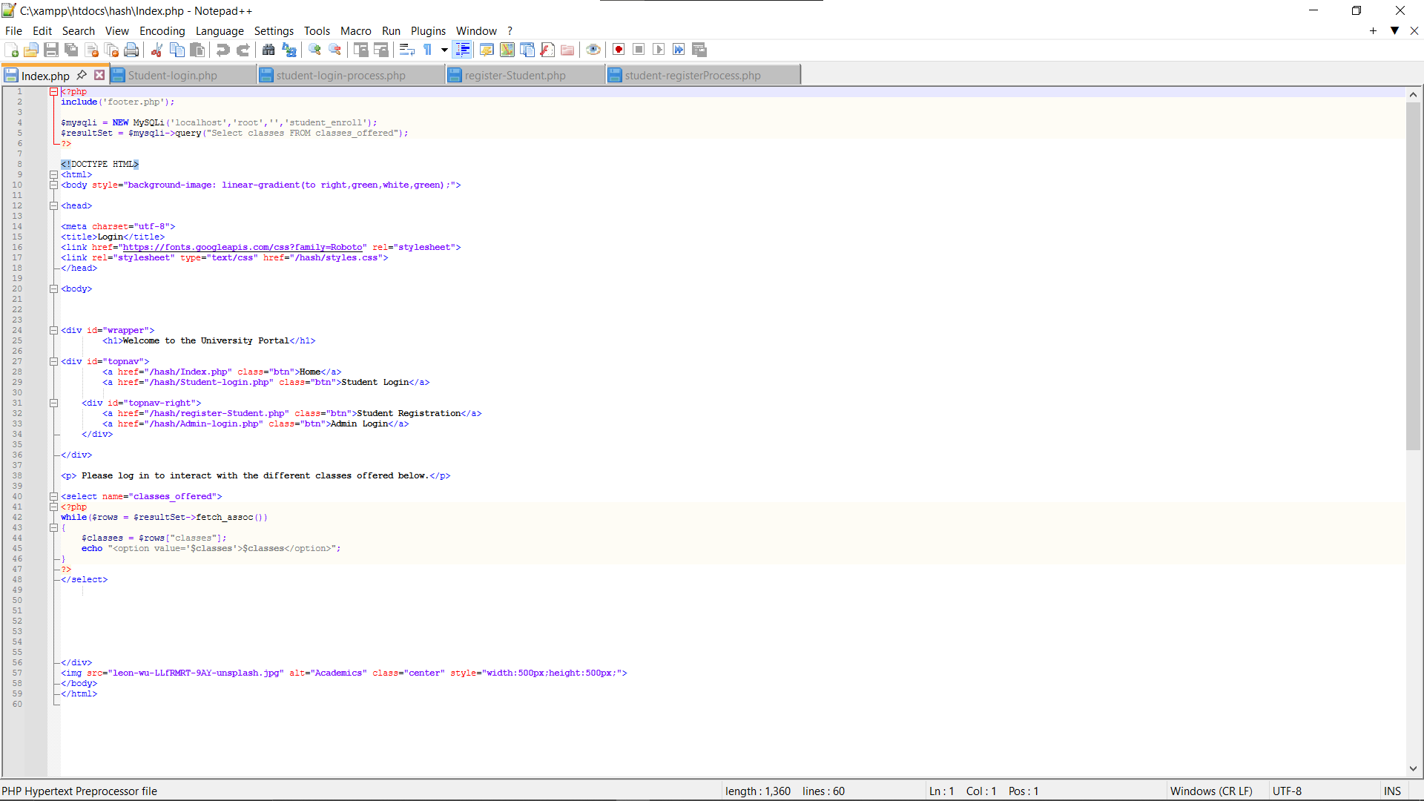
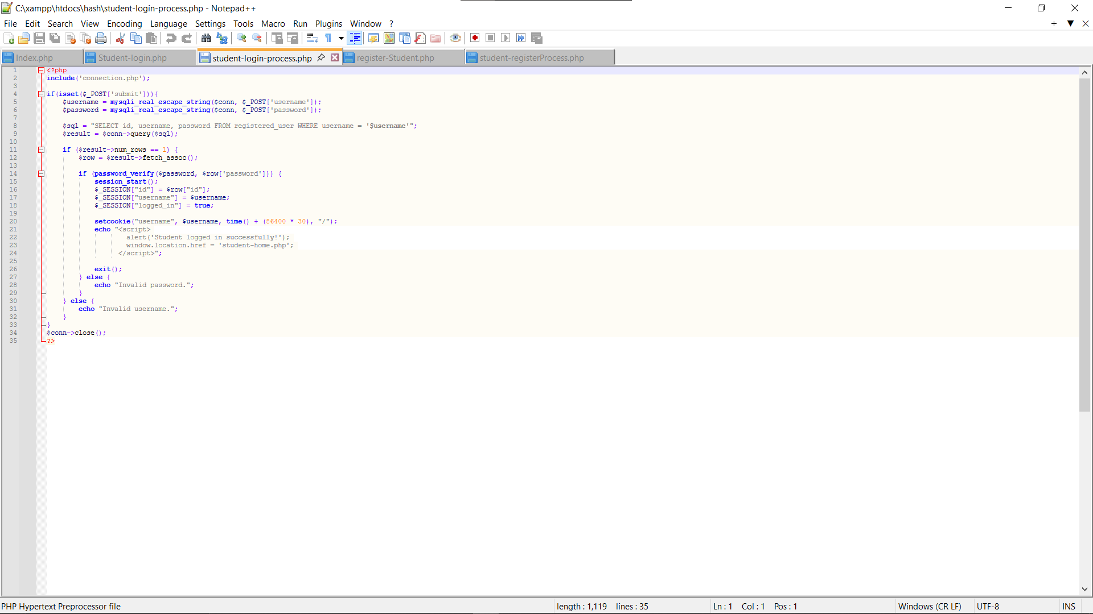
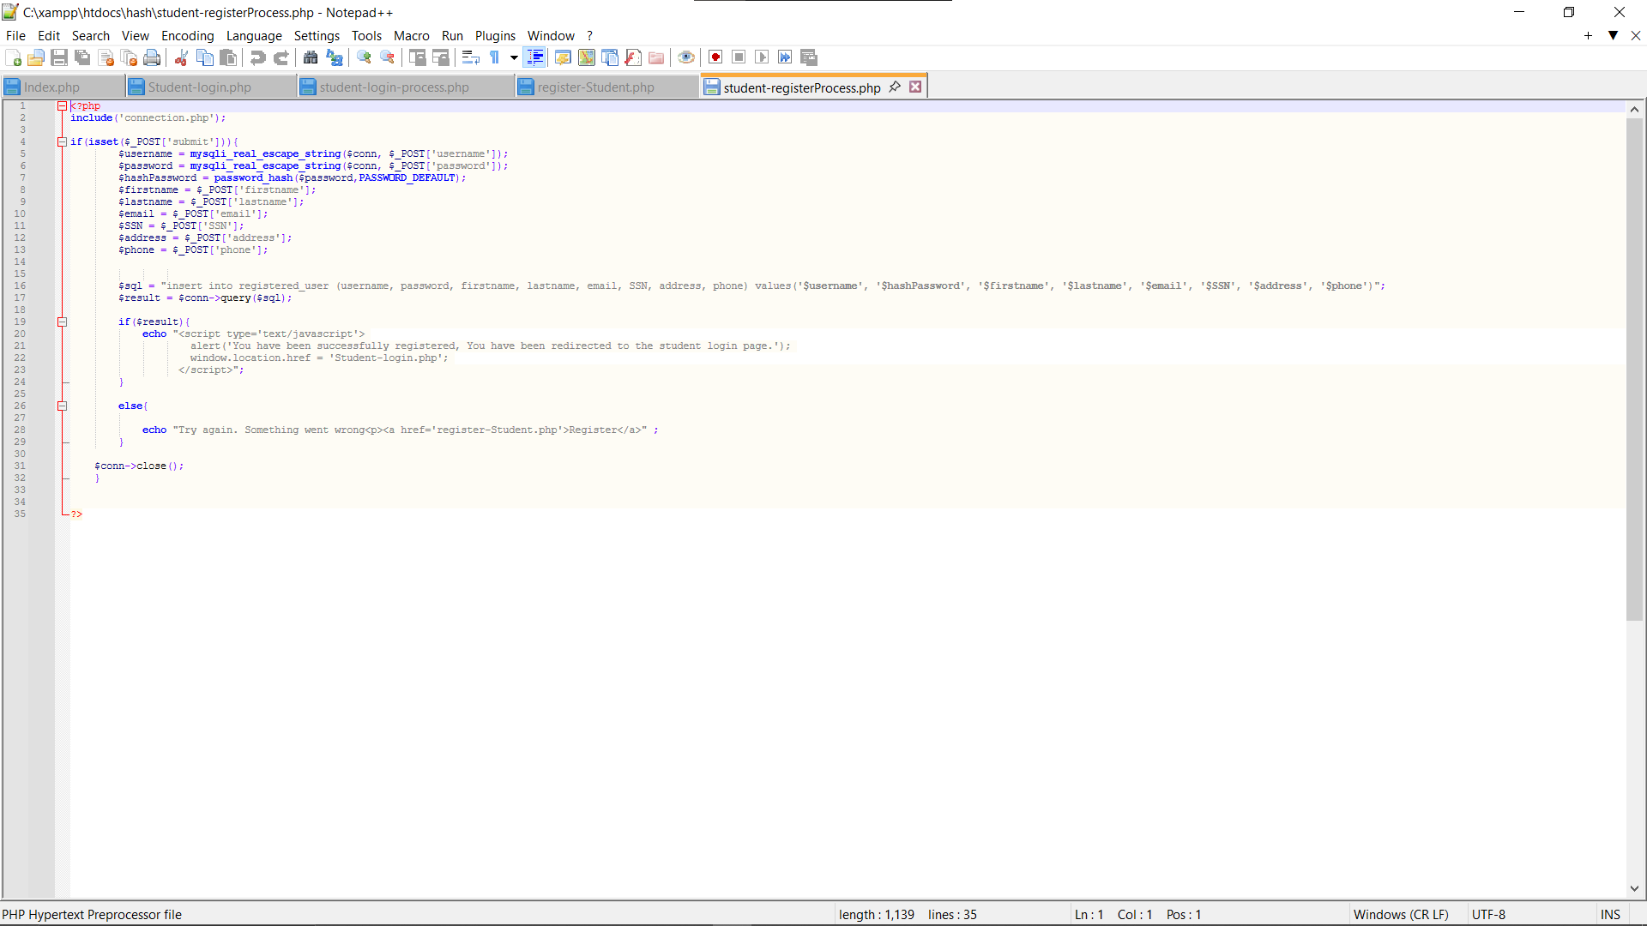
Enrollment for a User to Become a Student /PHP Code
Login Page for Students /PHP Code
Landing/Home Page for Users /PHP Code
Notes:
These are just 3 pages from the many on my website.
On the left is my Landing page or home page.
From this page, you can select several spots that fit your needs.
You can select the Home button to be redirected back to the landing page anytime by selecting Home on the Nav Bar.
On The Nav Bar, we have the
Student Login, where an already Registered Student can go to log in to their University Portal
Student Registration is where non-registered users can create an account to become registered students.
Admin Login is where an admin would go to create a new admin profile or log in
A little lower, there is a drop-down that currently says Computer Science, with a list of courses offered by this university.
To interact with any courses, you must be logged into a registered account, so it is important to be logged into your student portal or to register on the student registration if you do not have an account already.
Below the picture of the Landing page is the PHP code used for these far-right functions to work correctly and take you to the correct pages on the website.
In the Middle is my Enrollment Page.
This is what I consider User registration for enrolling Students. This is used when a non-student needs to register to become a student at the University. They must enter some desired information, like
a username and password.
As well as their personal information, such as
their first name, last name
email address, social security number
mailing address and phone number.
It will then check the database to ensure the username and password can be used, and their personal information is not stored on an already registered user's account.
Once validated and confirmed, they will receive a pop-up informing them they are a Registered Student.
The first PHP code under this picture is used to allow the student to see this webpage and enter their information
While the Second PHP code under this picture Validates the information received from the user, enters it into the tables, and gives them a confirmation pop-up on whether it is successful.
My login page is in the far-right picture.
The top one shows the login page for the student, where the student will log in to gain access to their student portal.
Users will log in using their Username and the password they entered upon registration
Under this picture are the two codes used.
The 1st code allows students to see this webpage and enter their username and password.
While the 2nd code is used to validate their inputted information with the database to ensure the username and password match an account before being logged in.
NEXT PAGE:
Up Next is three more pages, including the Student Home Page, Course Registration Pages

Slide 7
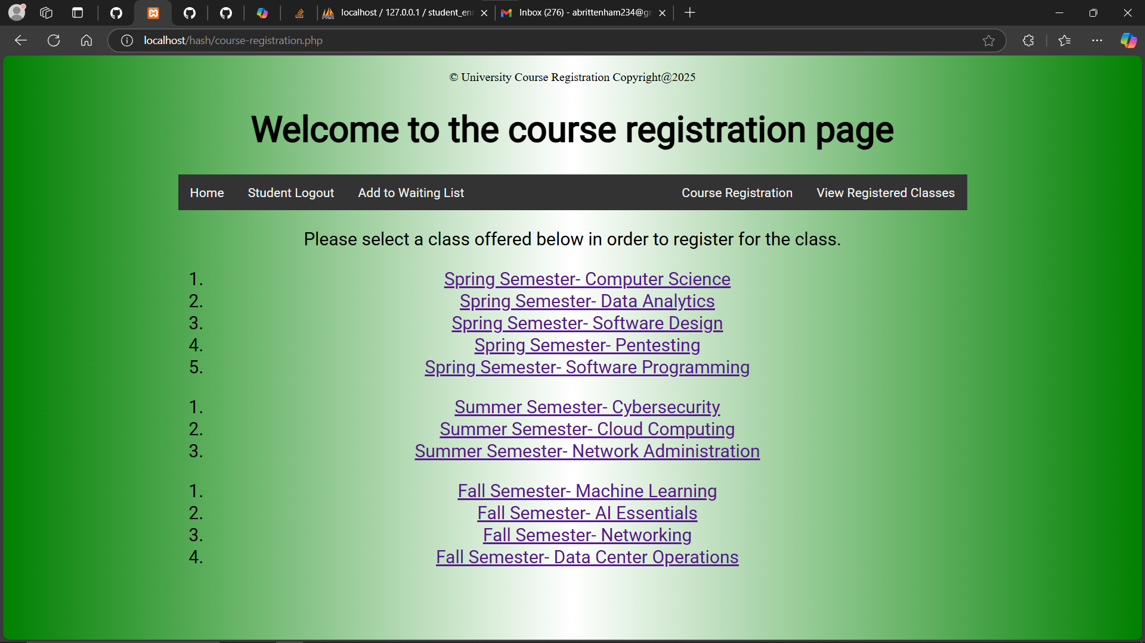
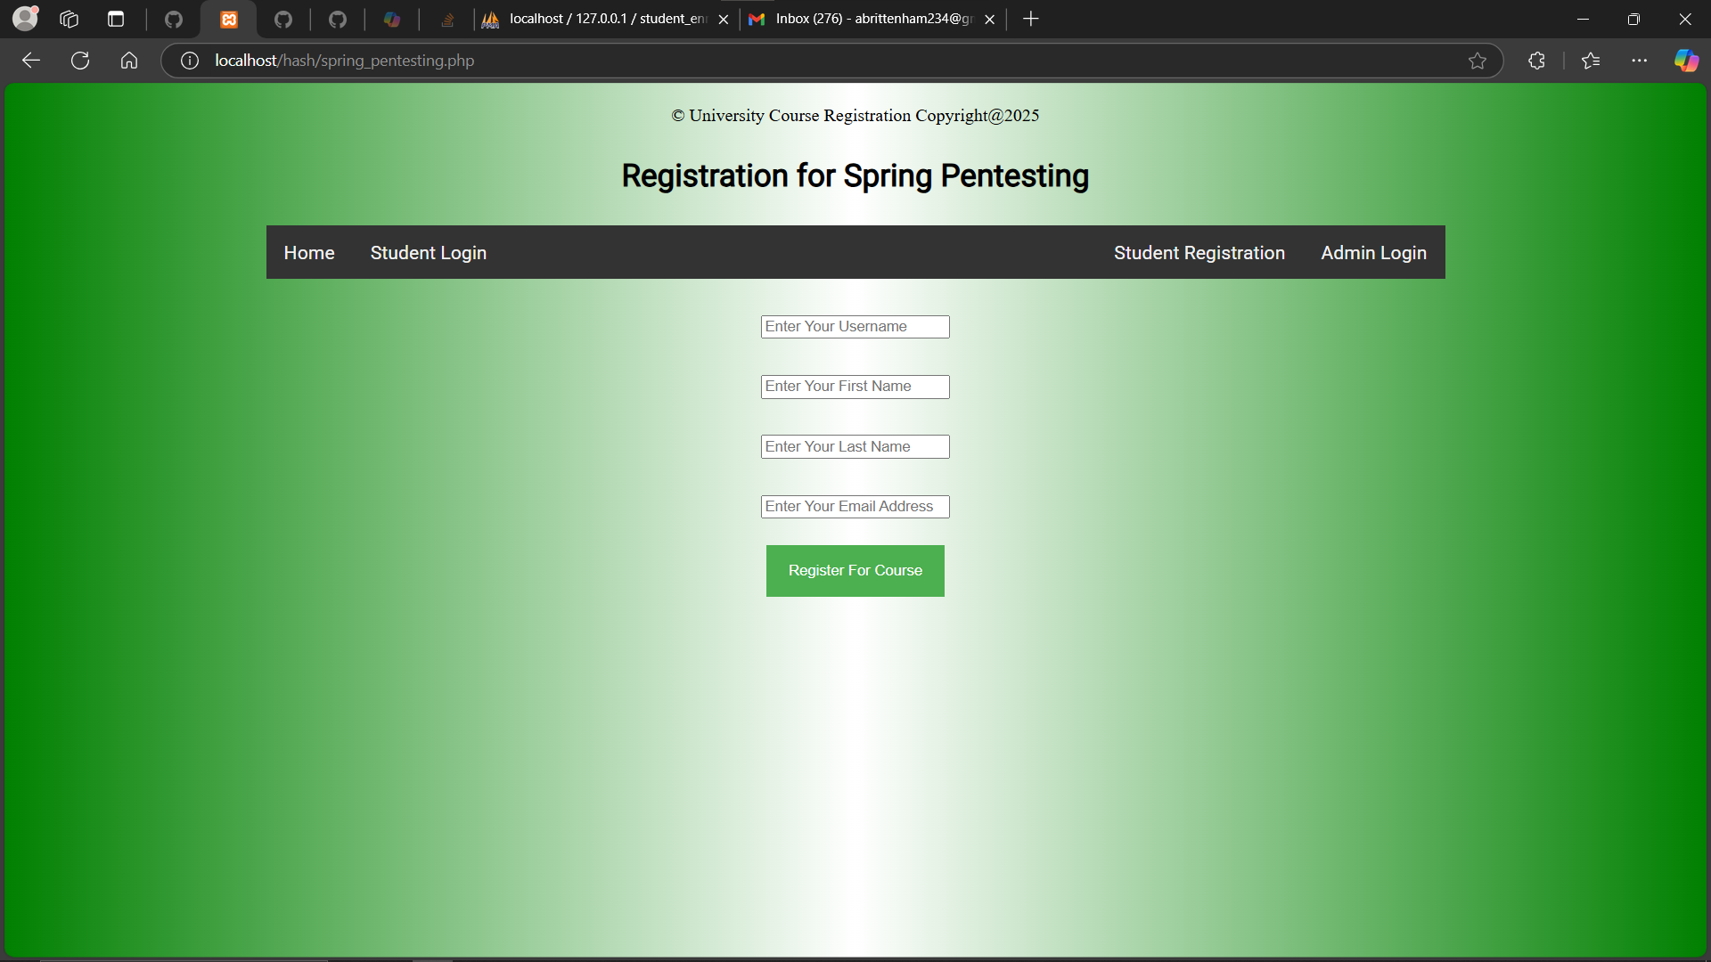
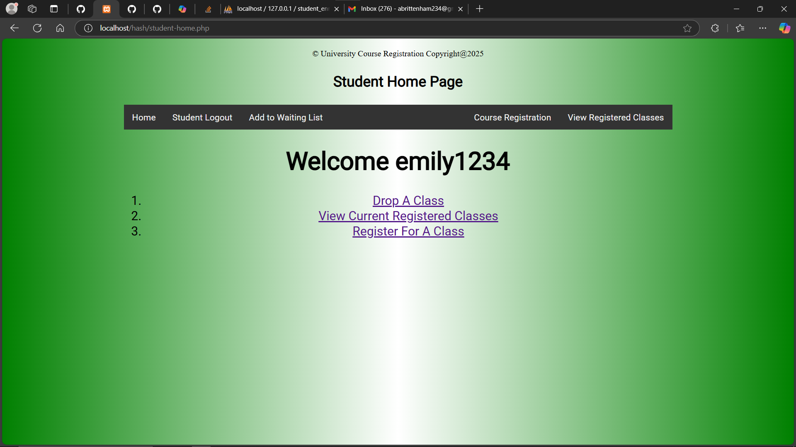
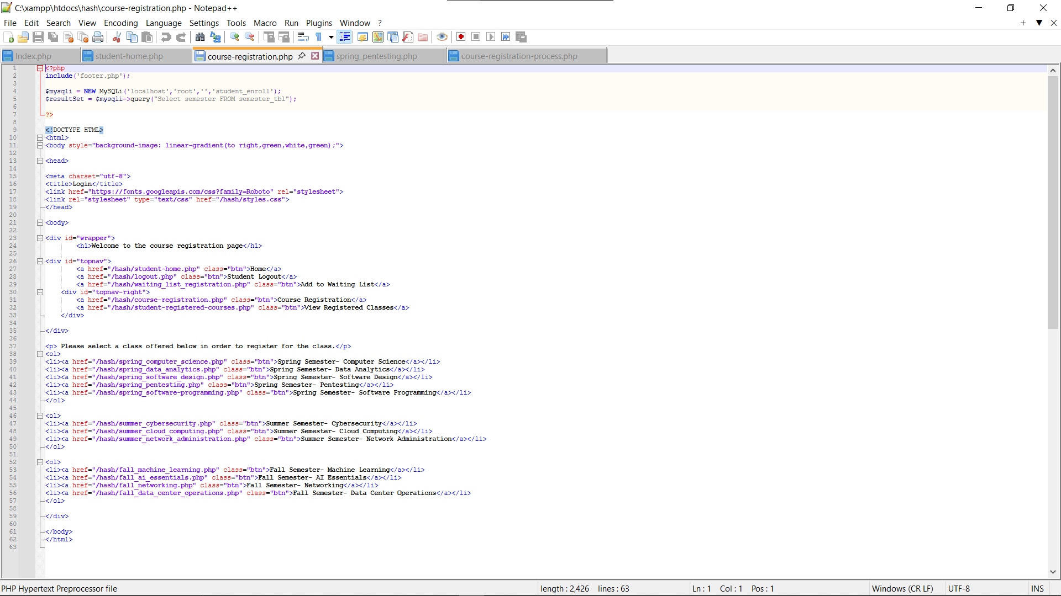
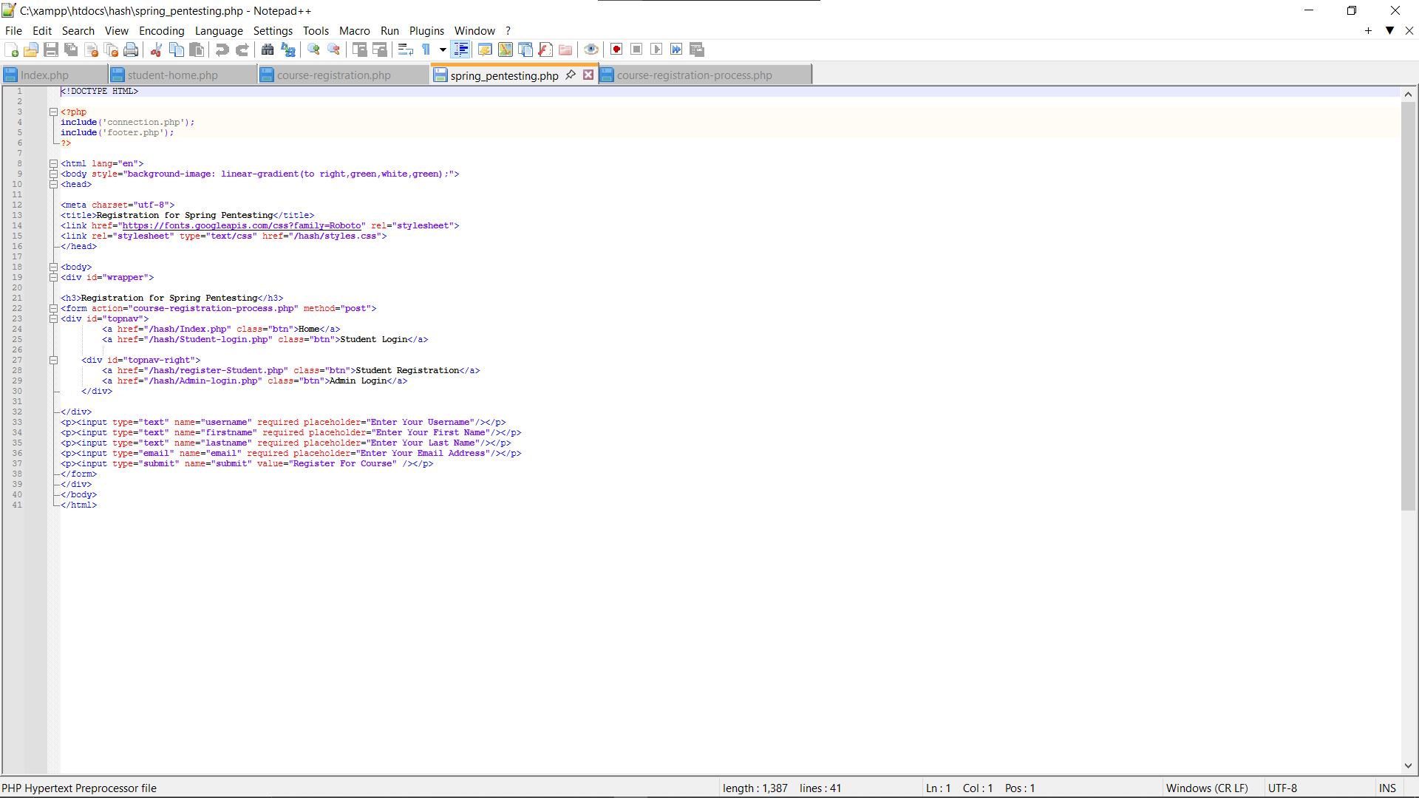
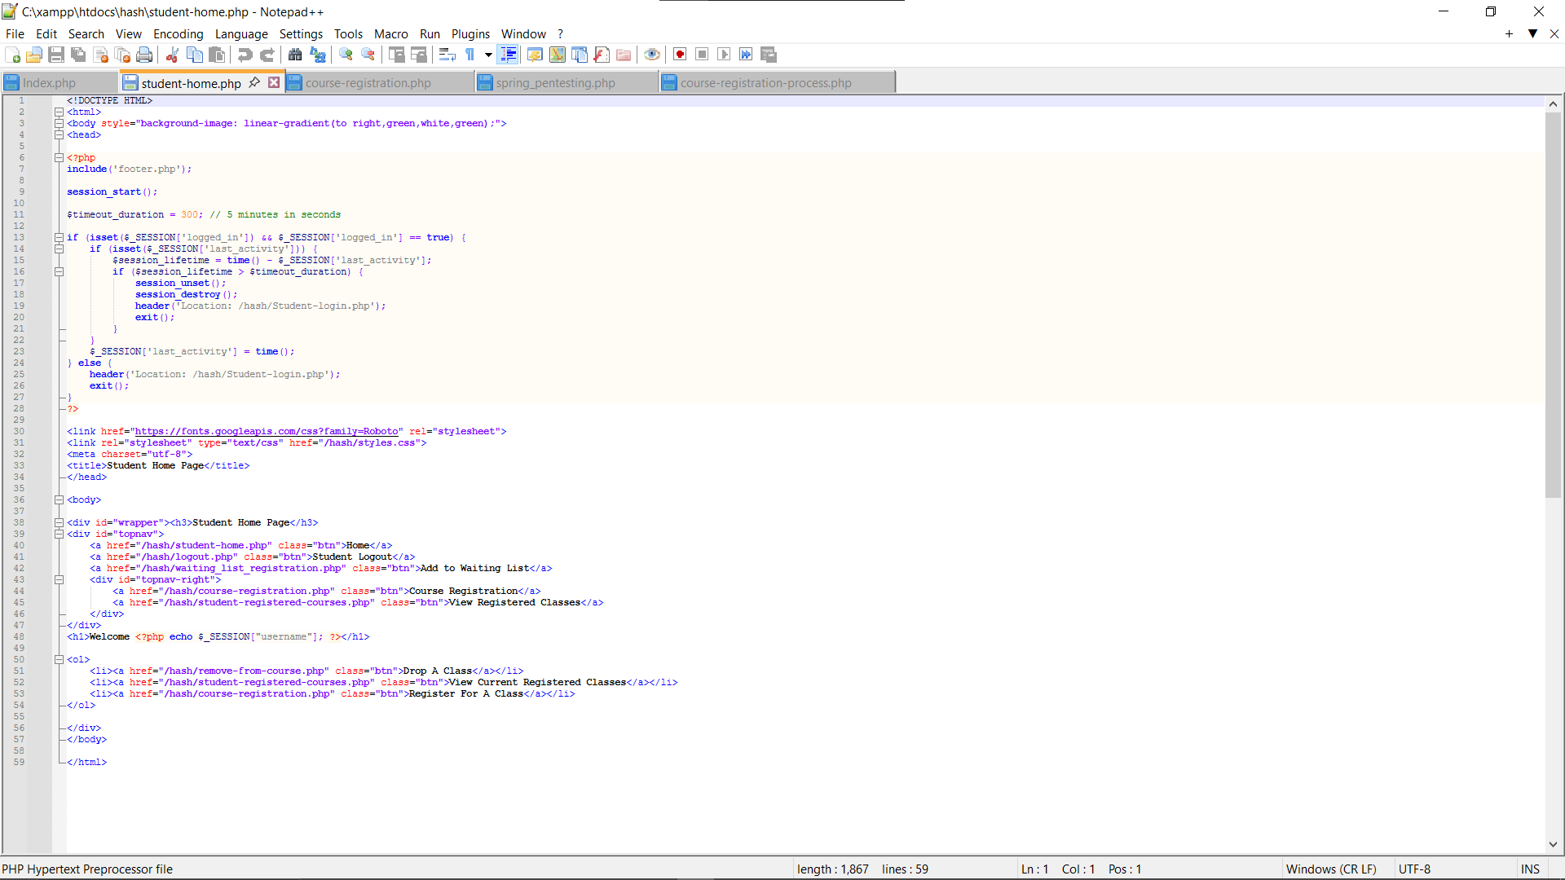
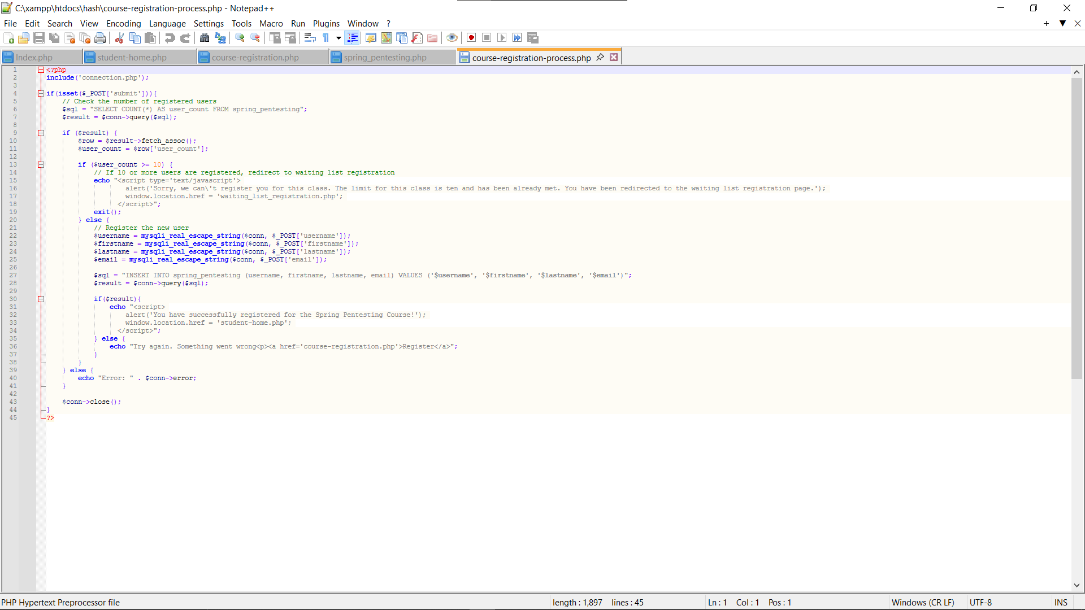
Student Home Page/PHP Code
Classes to register for/PHP Code
Enter Student Information to Register /PHP Code
Notes:
The First Picture in the Left on the top row shows the Student Home Page. It has a navigation bar that will allow the student to navigate to different areas if desired. It also welcomes the student; for this picture, it welcomes Emily1234.
You will use this page a lot to navigate through different aspects of the portal.
You can Logout
Add to a waitlist
Register for a class
view registered classes
or drop a class.
Right under this picture, you will see the code I used to ensure that this page fully functions and allows the student to access all the tables and the desired information needed for this project.
The Course Registration Page has two parts First is having to select which class you want to register for
This being said, this middle picture shows the courses this student can register for.
There are 5 Spring Semester, 3 Summer Semester, and 4 Fall Semester Classes offered.
For the student to enroll in one of these courses, they just have to click on the class, and then it takes them the registration form for that particular class.
The code used for this page to direct the student to the correct registration page is listed under this picture.
The last picture on the top row shows the Registration Page for the Pen testing Class, one of the courses offered.
The student will enter their information in these boxes before clicking the green Register for Course Button.
Below this picture are two screenshots of the PHP code.
The first one shows the PHP code for the Spring Pen Testing Class Registration.
However, the Second PHP code ensures there is enough room in the class for the student. If there is room, the student is registered for the class; however, if the class is full, the student is notified and redirected to the waitlist registration page.
My login page is in the far-right picture.
The top one shows the login page for the student, where the student will log in to gain access to their student portal.
Users will log in using their Username and the password they entered upon registration
Under this picture are the two codes used.
The 1st code allows students to see this webpage and enter their username and password.
While the 2nd code is used to validate their inputted information with the database to ensure the username and password match an account before being logged in.
NEXT PAGE:
Up Next is two more pages, including the Registration for Waitlist and View Registered Courses

Slide 8
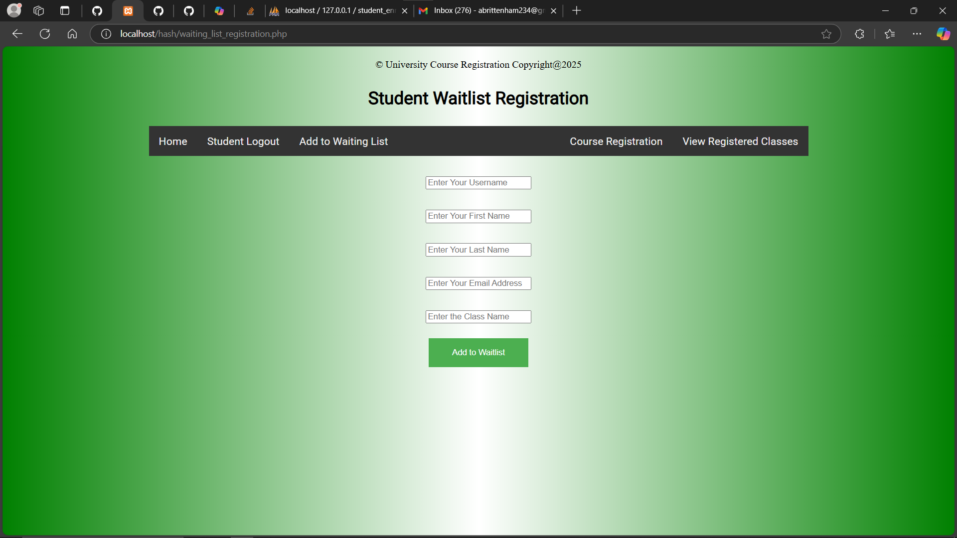
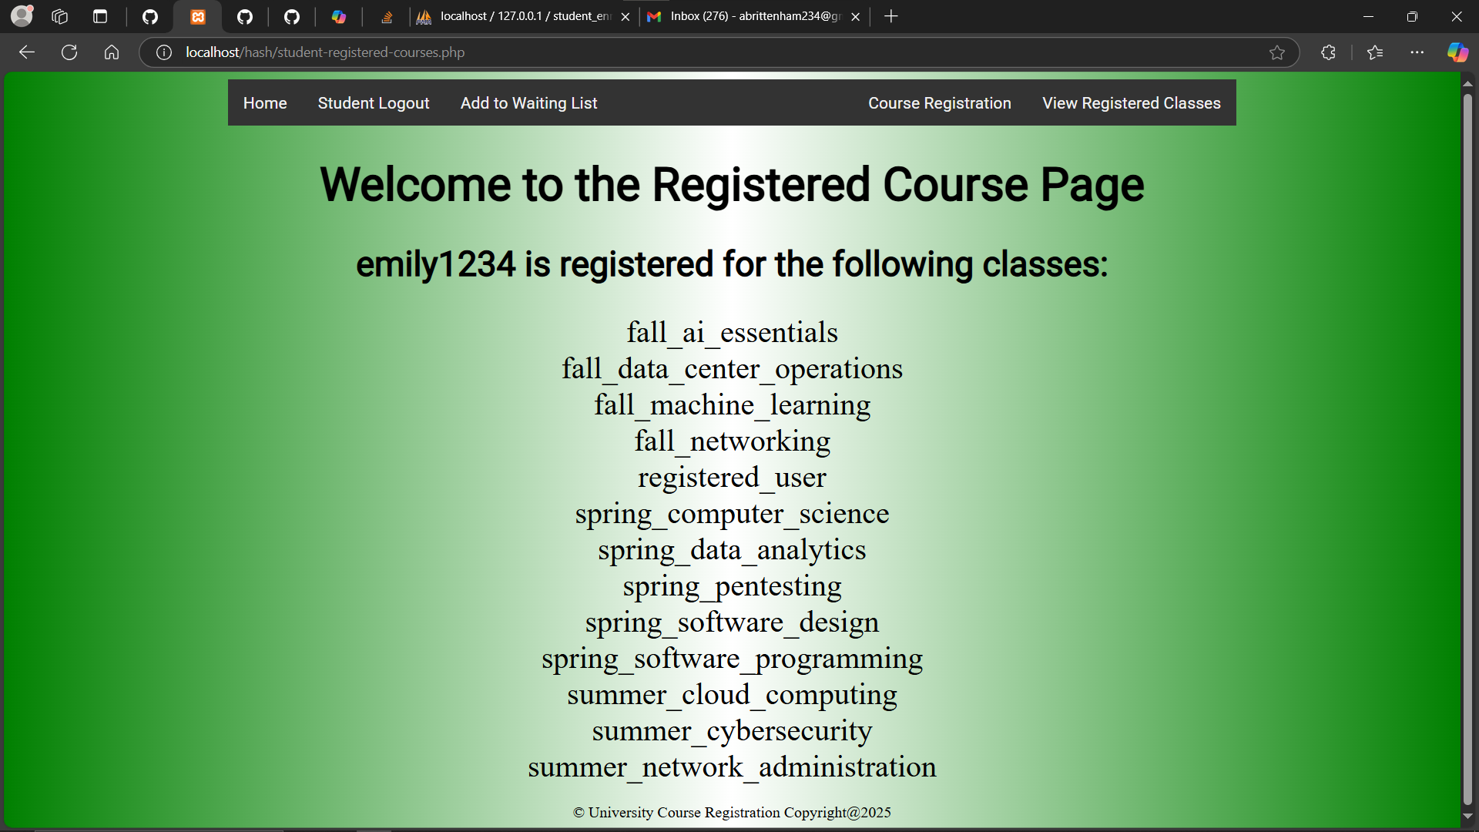
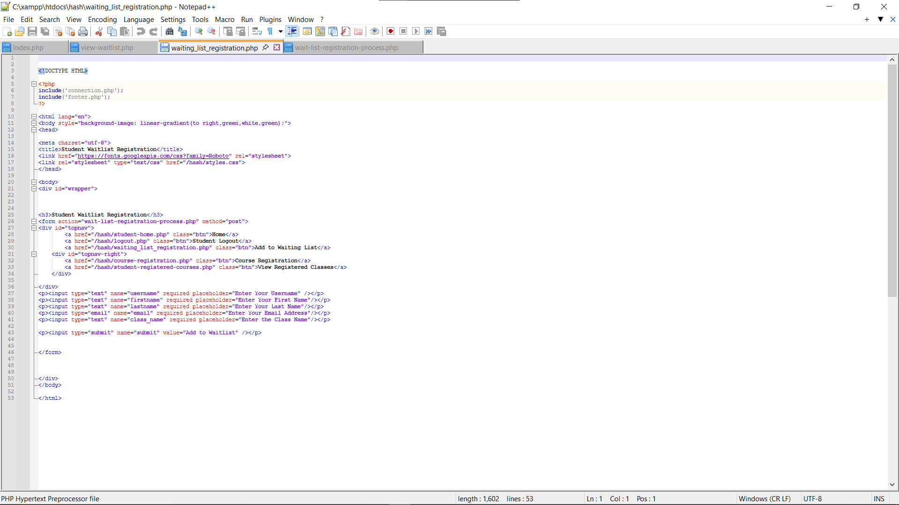
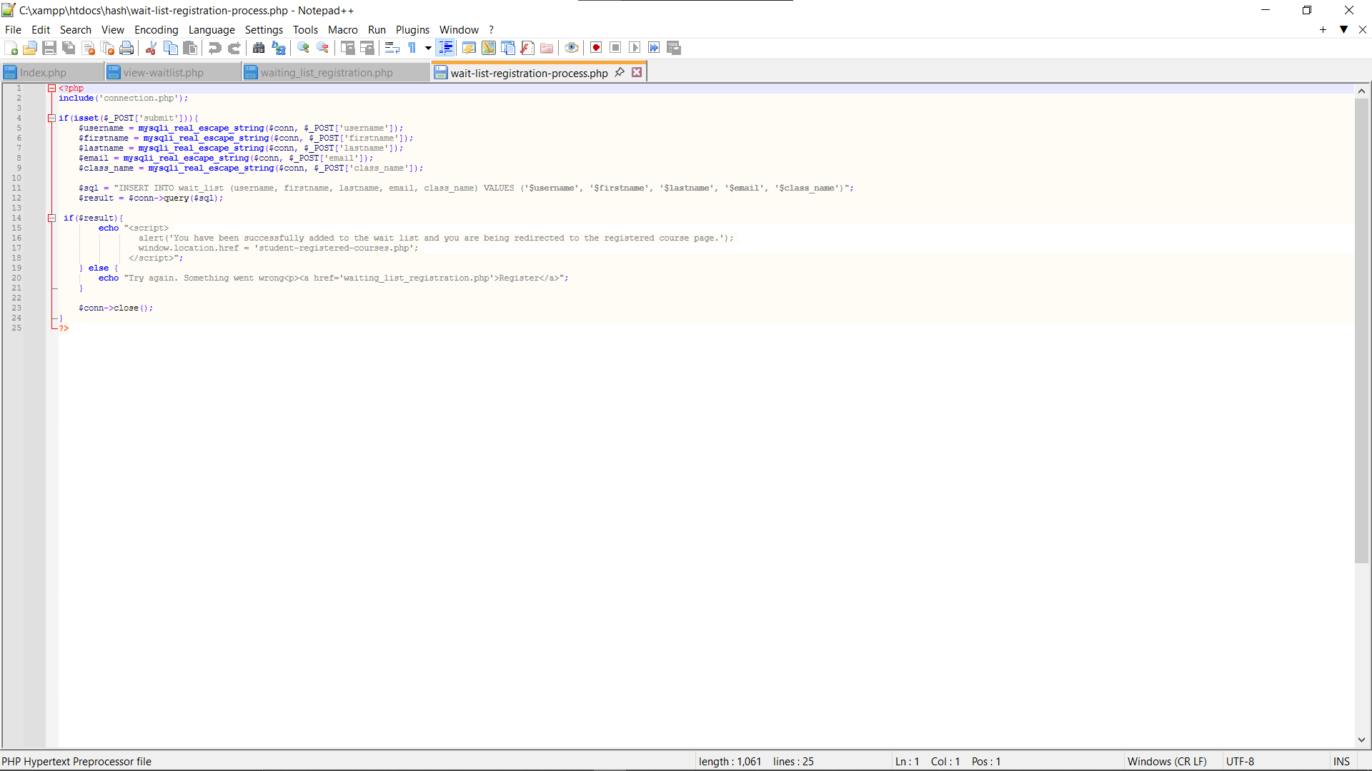
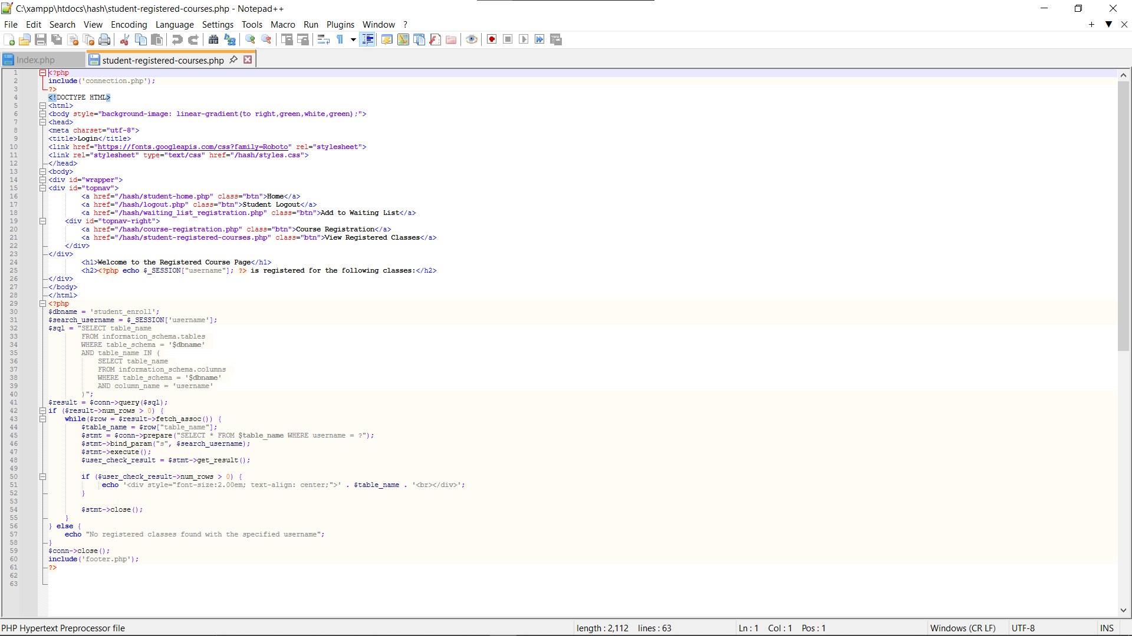
Registration for Waitlist/PHP Code
View Registered Courses/PHP Code
Notes:
This page Talks about the registration and the PHP code needed to ensure it runs correctly and effectively
On the Top Left Is a Screenshot of the Student Waitlist Registration.
This is where the student receives a pop-up saying the class they are registering for is full; it will redirect them to this page so they can enter their information here before selecting add to the waitlist.
The 1st PHP code under this picture is the code take that takes the student’s information and starts the waitlist registration process.
The 2nd PHP code enters the student’s information into the database.
On the Top Right is a screenshot of Emily1234’s Registered Courses.
This tells the student if they are on a waitlist and what classes they are registered for.
Below this Screenshot is the PHP code used to ensure that it pulls every class or table this student is on and displays them on this registered course page!
NEXT PAGE:
Next, a few more pages talk about dropping a class and the PHP code that ensures that it drops the student from that class correctly.

Slide 9
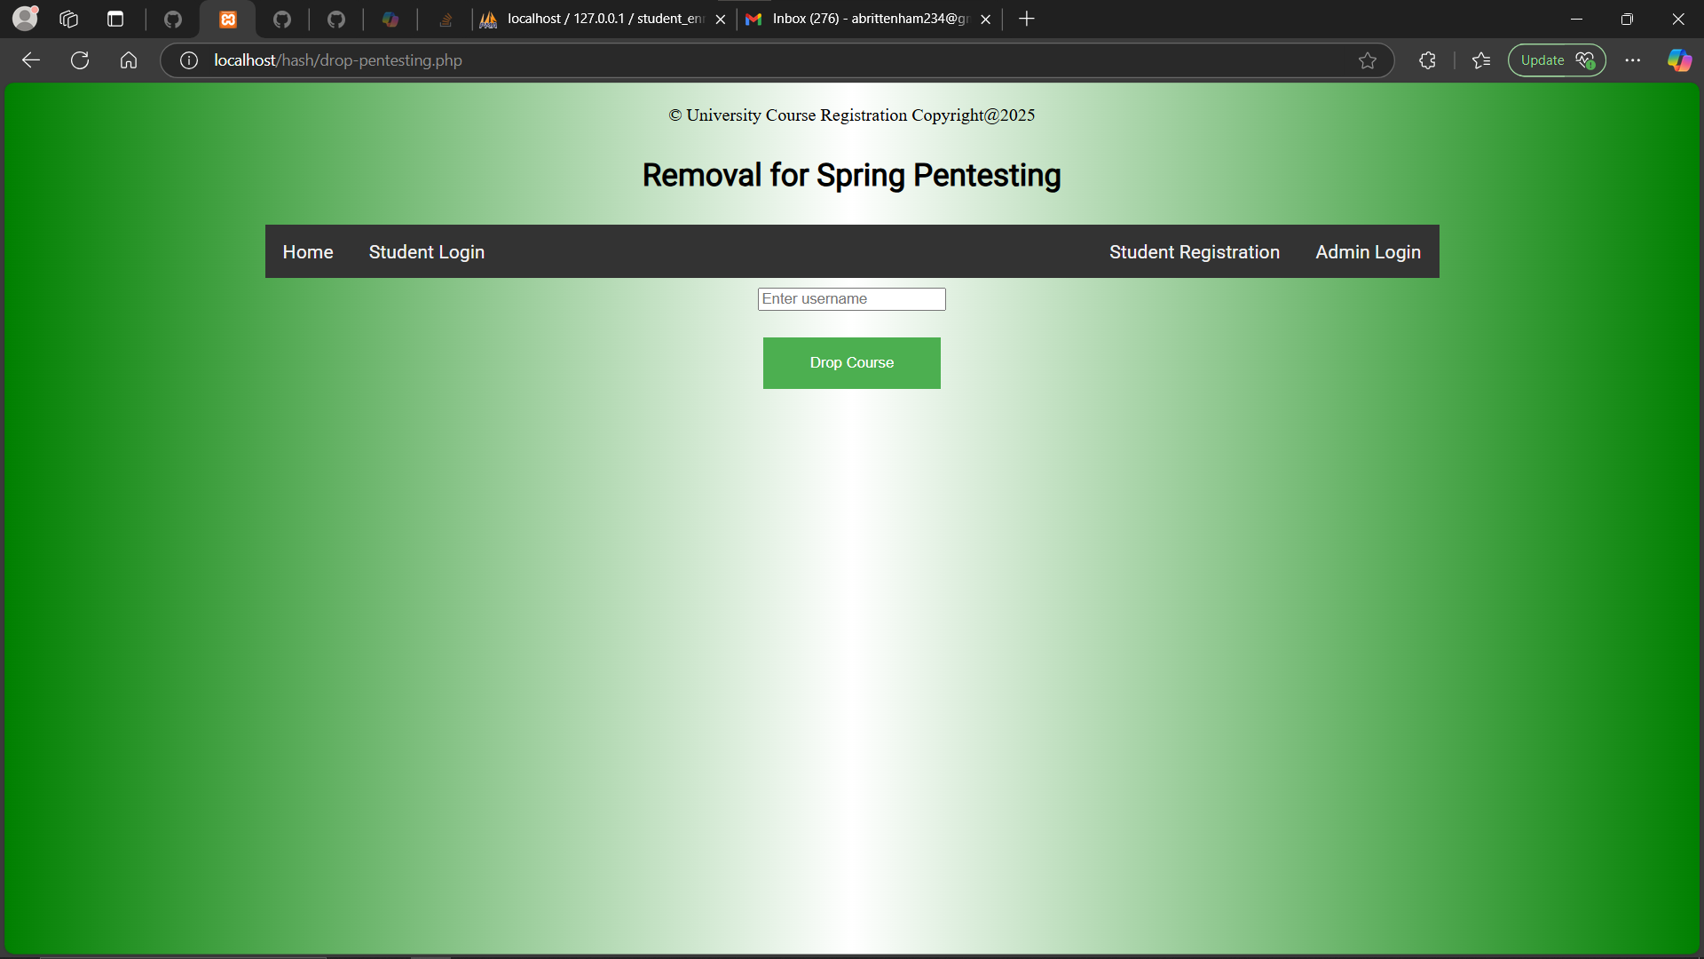
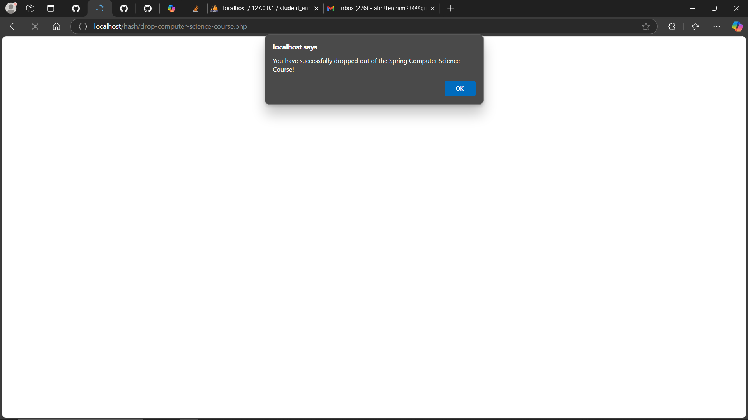
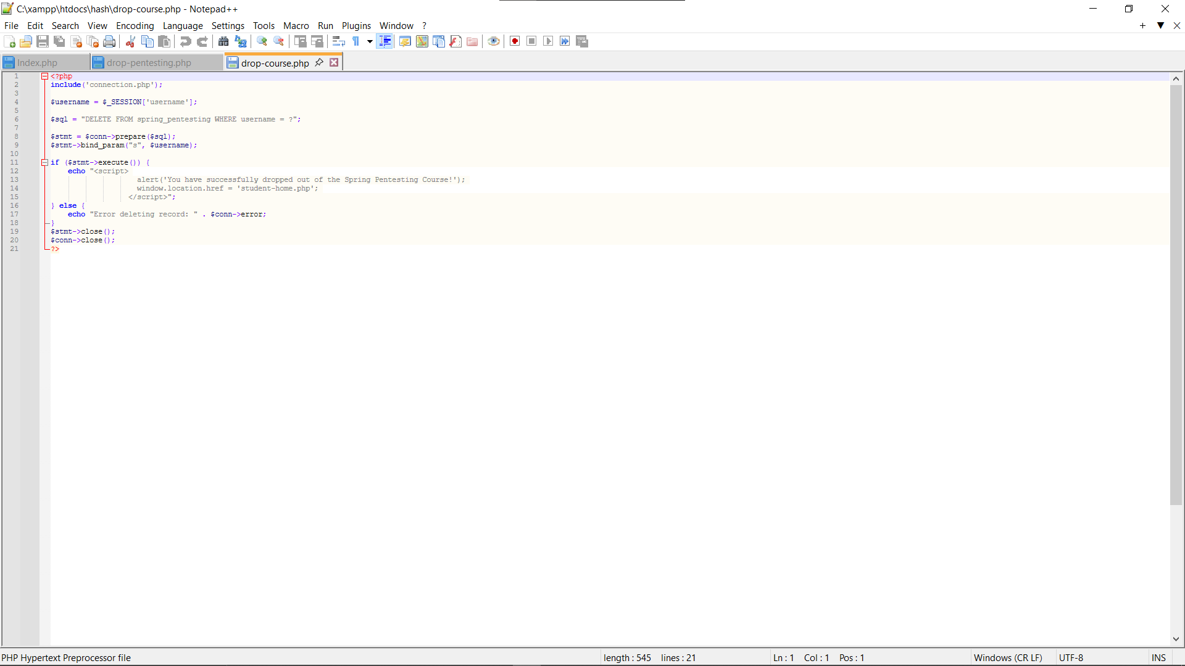
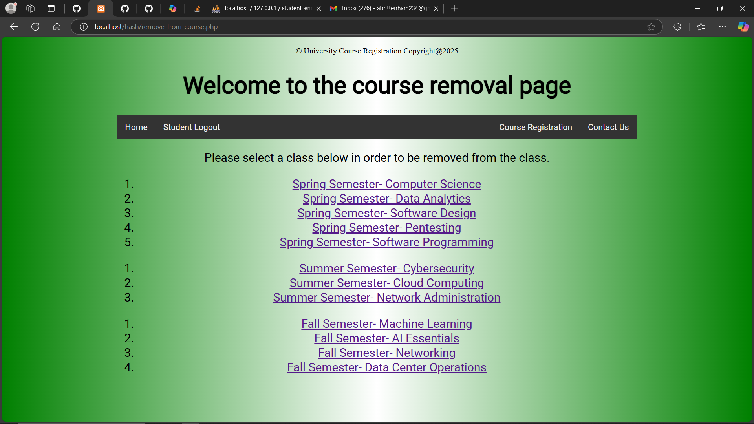
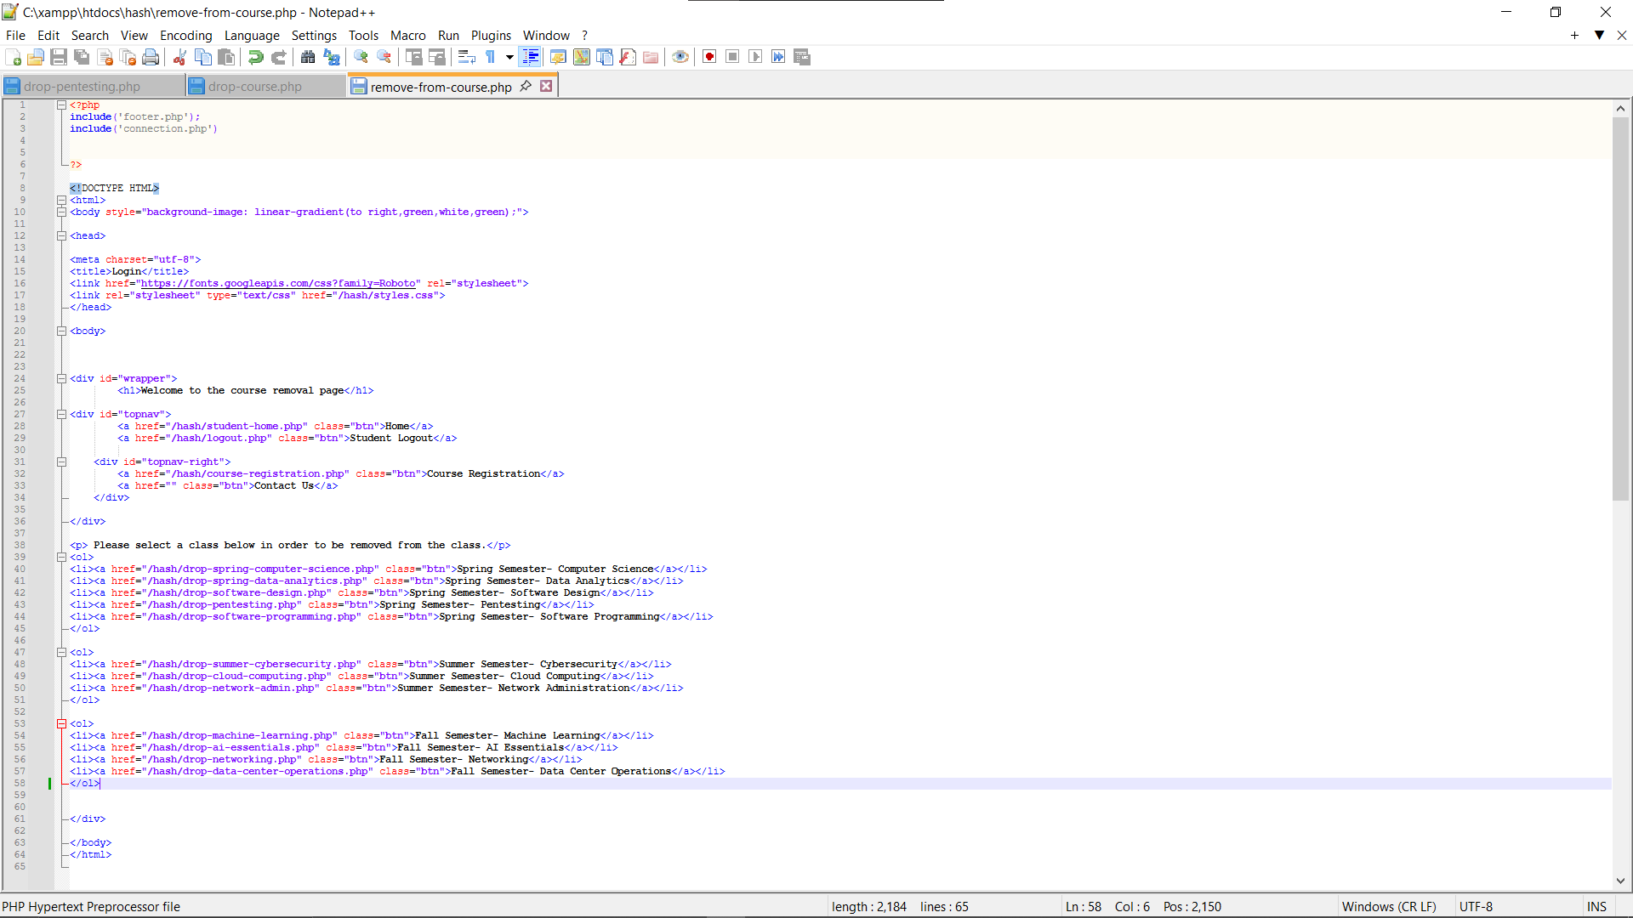
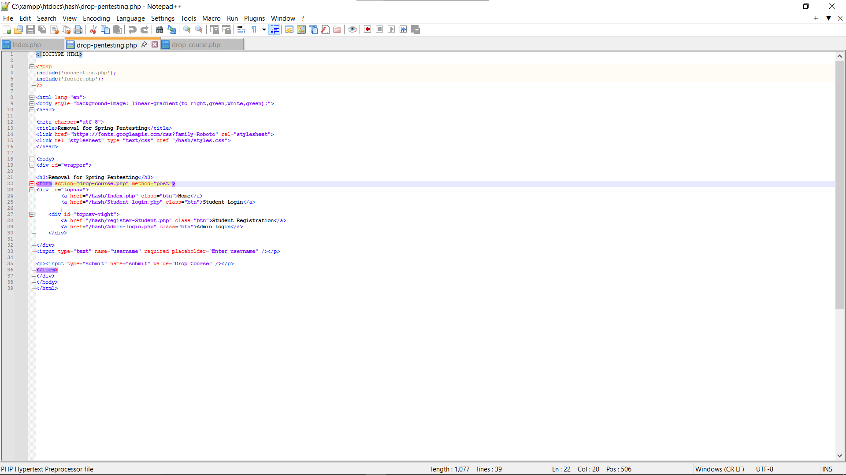
Select Course to drop/PHP Code
Student Homepage
The 1st step to drop the Course/PHP Code
Last step and Confirmation of Dropped Class/PHP Code
Notes:
This first Screenshot on the top left again shows Emily1234’s Homepage. If Emily is enrolled in Spring Pen Testing and wants to remove herself from this class, she will click the drop a class button on this homepage.
Right under that picture is the Selecting Course to drop. This page is called the Course Removal page and lists all the university classes.
In this case, Emily1234 would click the Spring Pen Testing option on this page.
The PHP code for the course removal page ensures that the classes are displayed and redirects them to the correct removal page based on their choice of class, as shown directly to the right of this picture.
It would then direct Emily 1234 to the Spring Pen testing Removal Page as shown in the middle green picture. Emily1234 Would enter her username before selecting drop course
Under this picture is the PHP code that allows the student to enter their Username and select the drop course to start the removal process.
The last Picture on the far right is the pop-up that shows that the student has fully been dropped from the Pen Testing Class and the
PHP code fully takes them out of the class and gives them a pop-up before redirecting them back to the Student homepage.
NEXT PAGE:
Up Next is The start of my Admin Pages

Slide 10
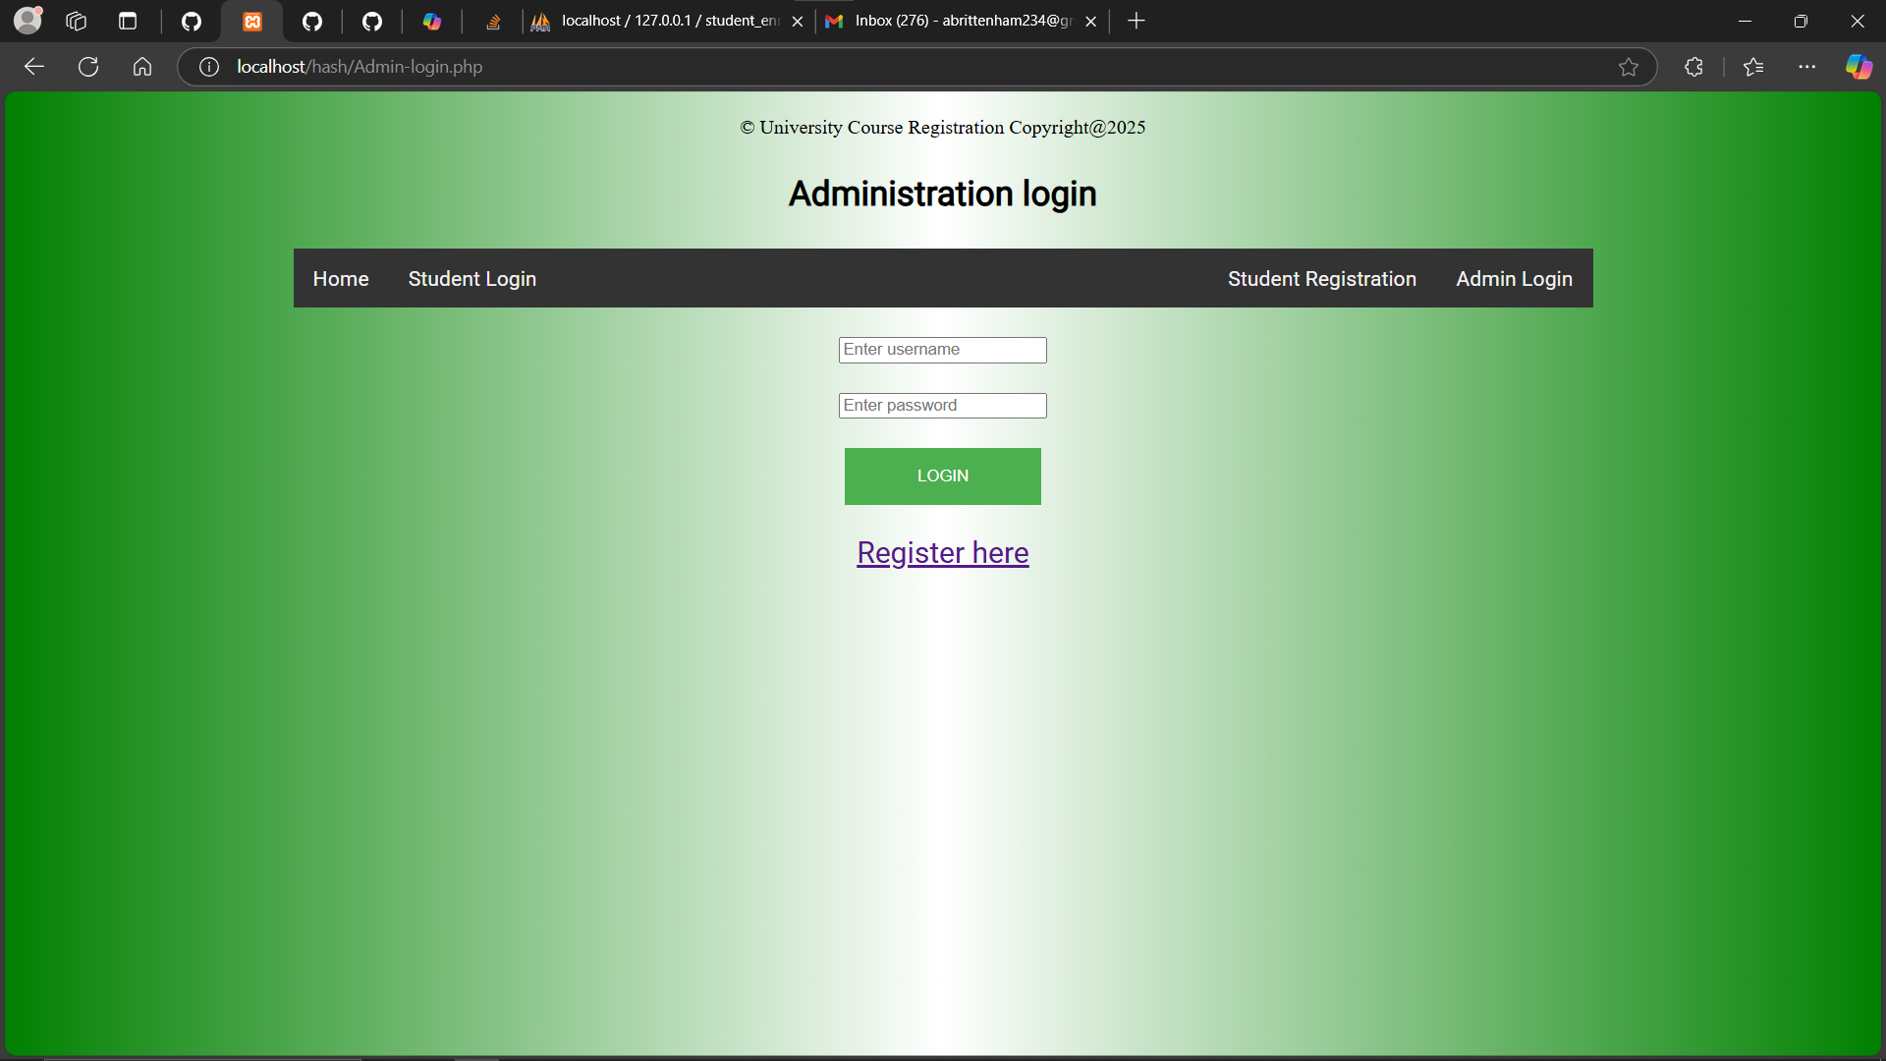
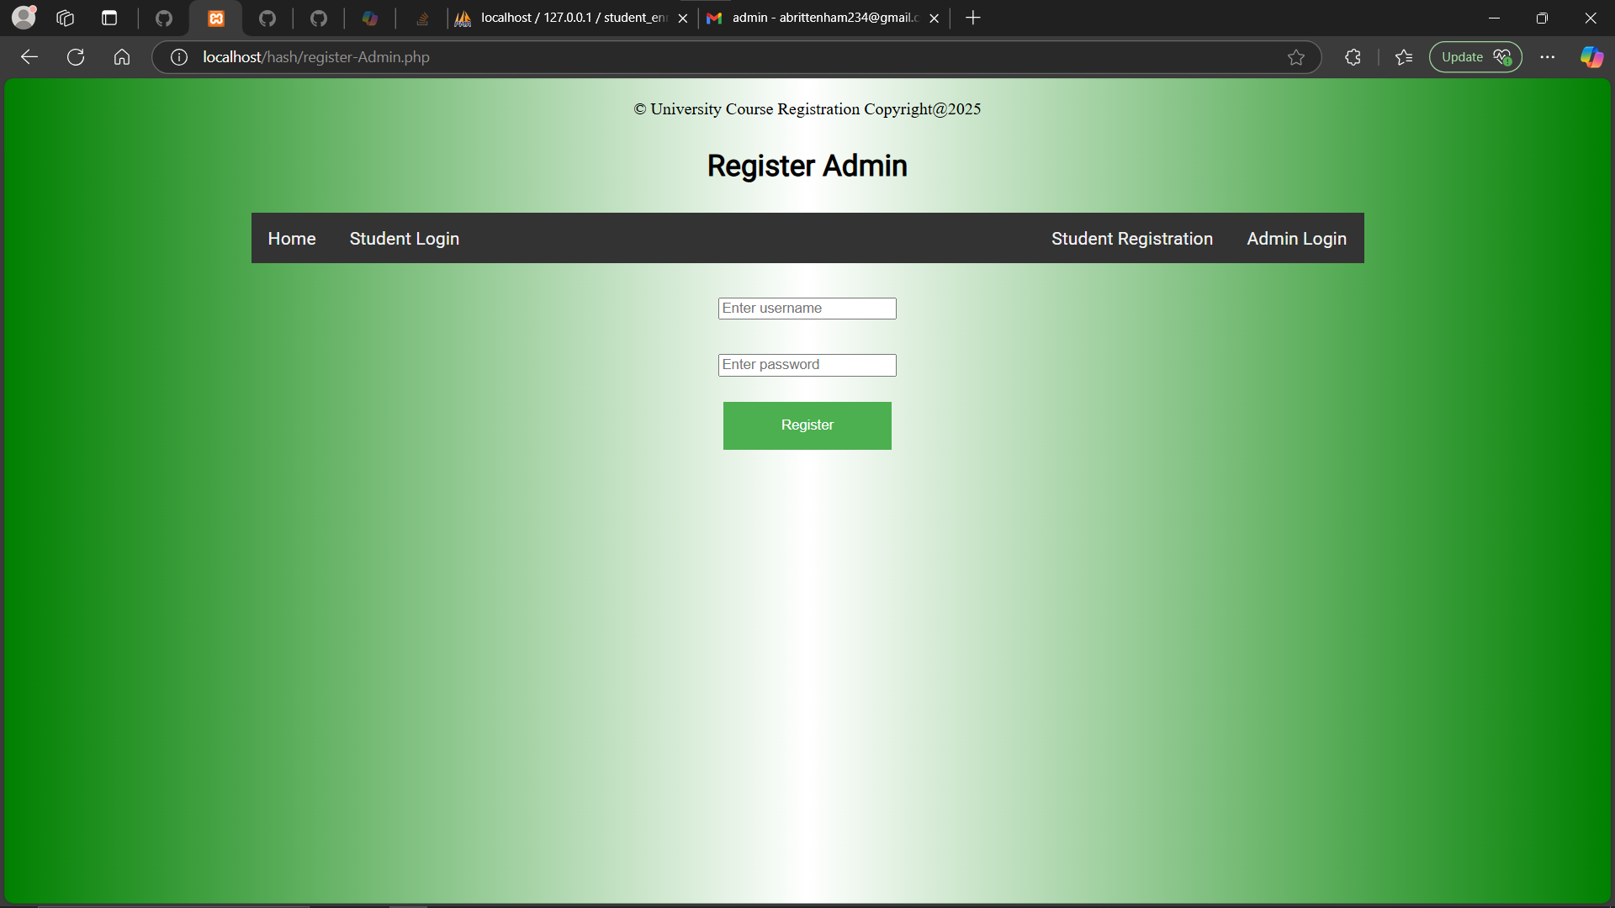
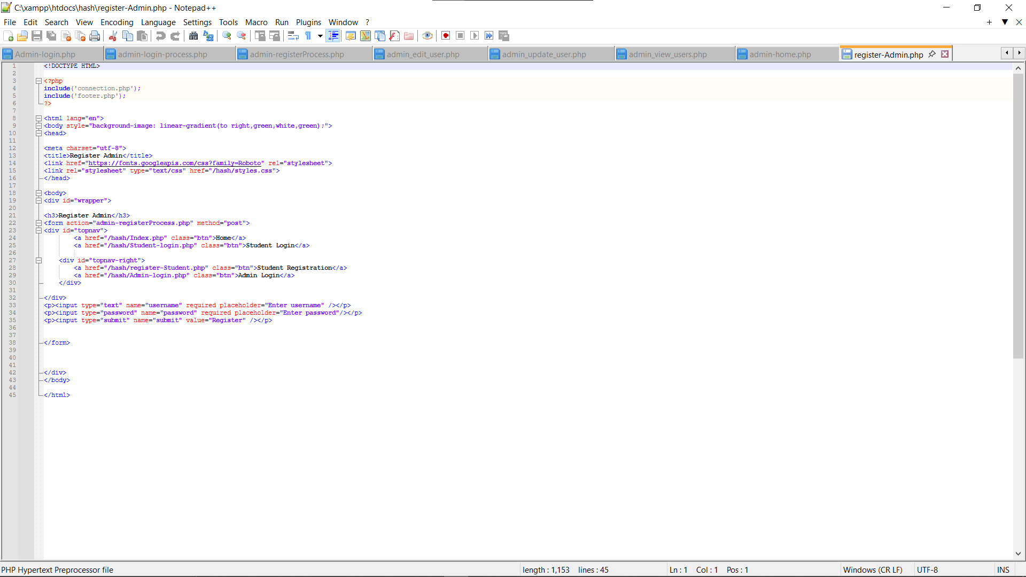
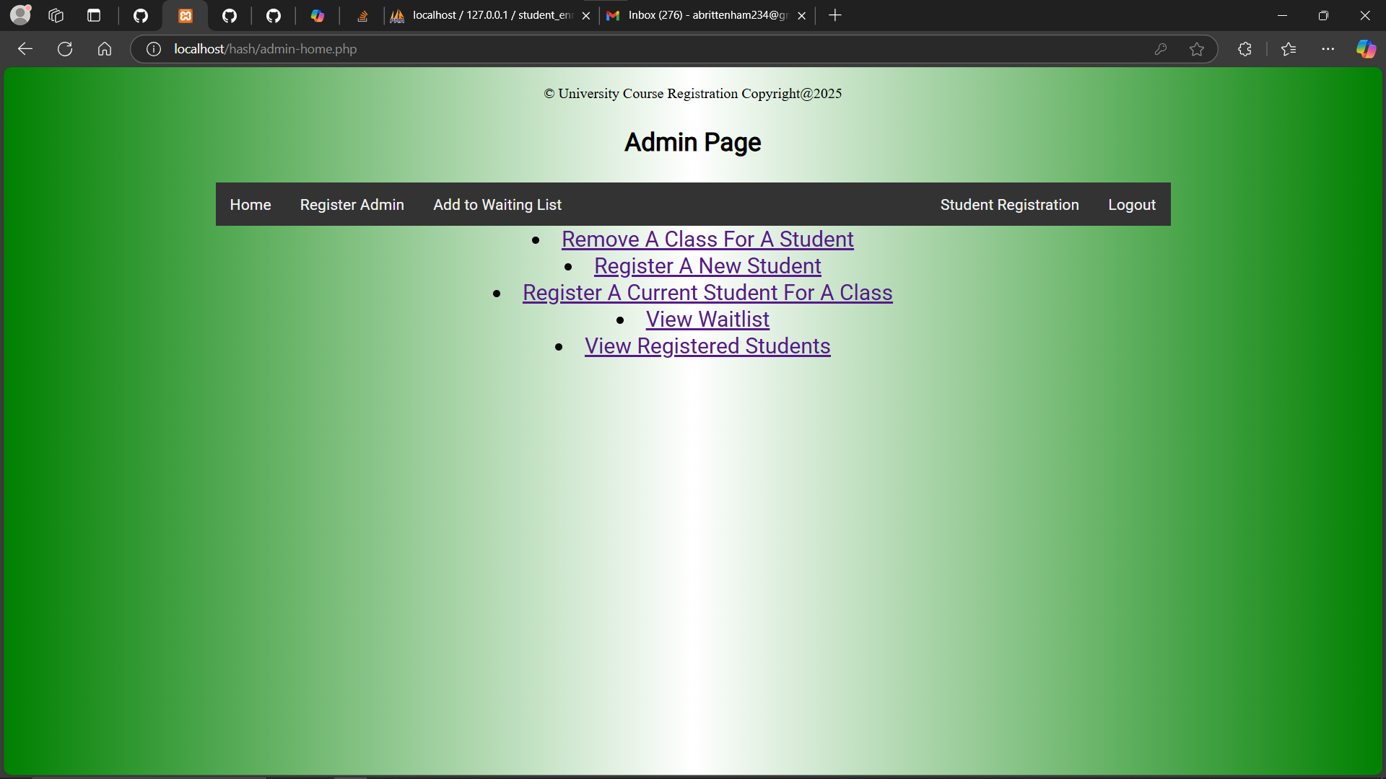
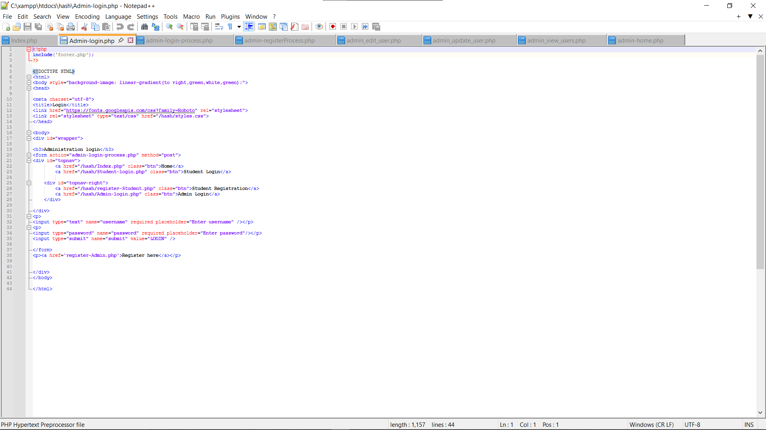
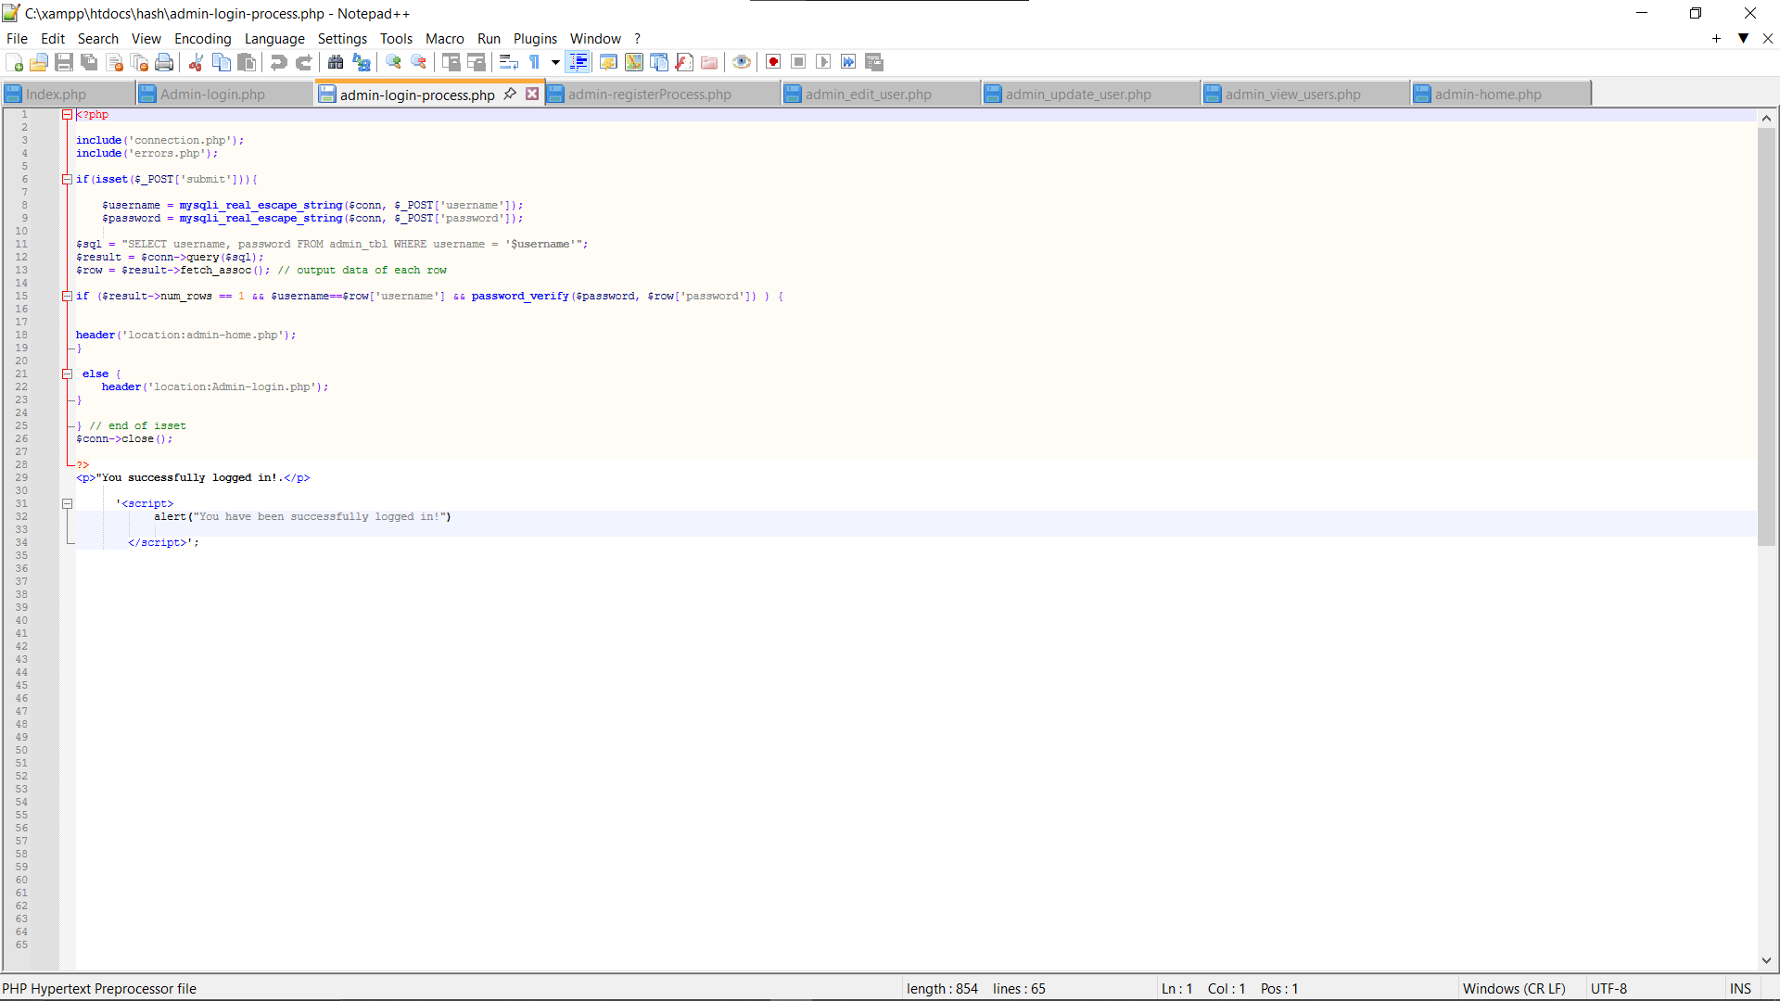
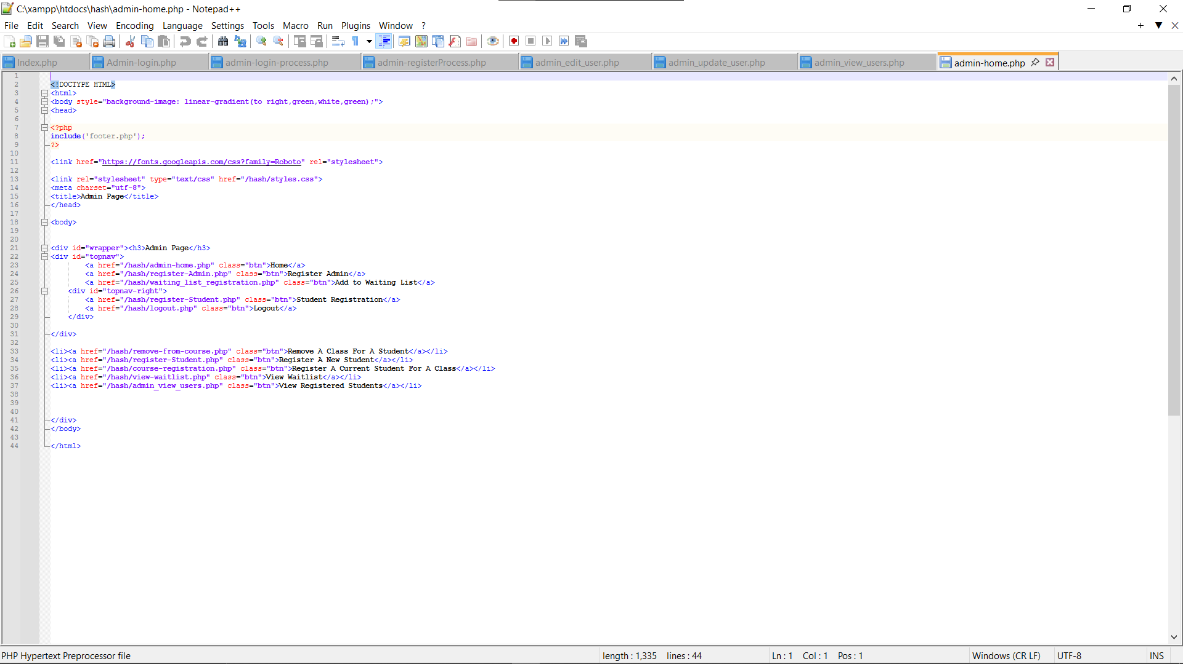
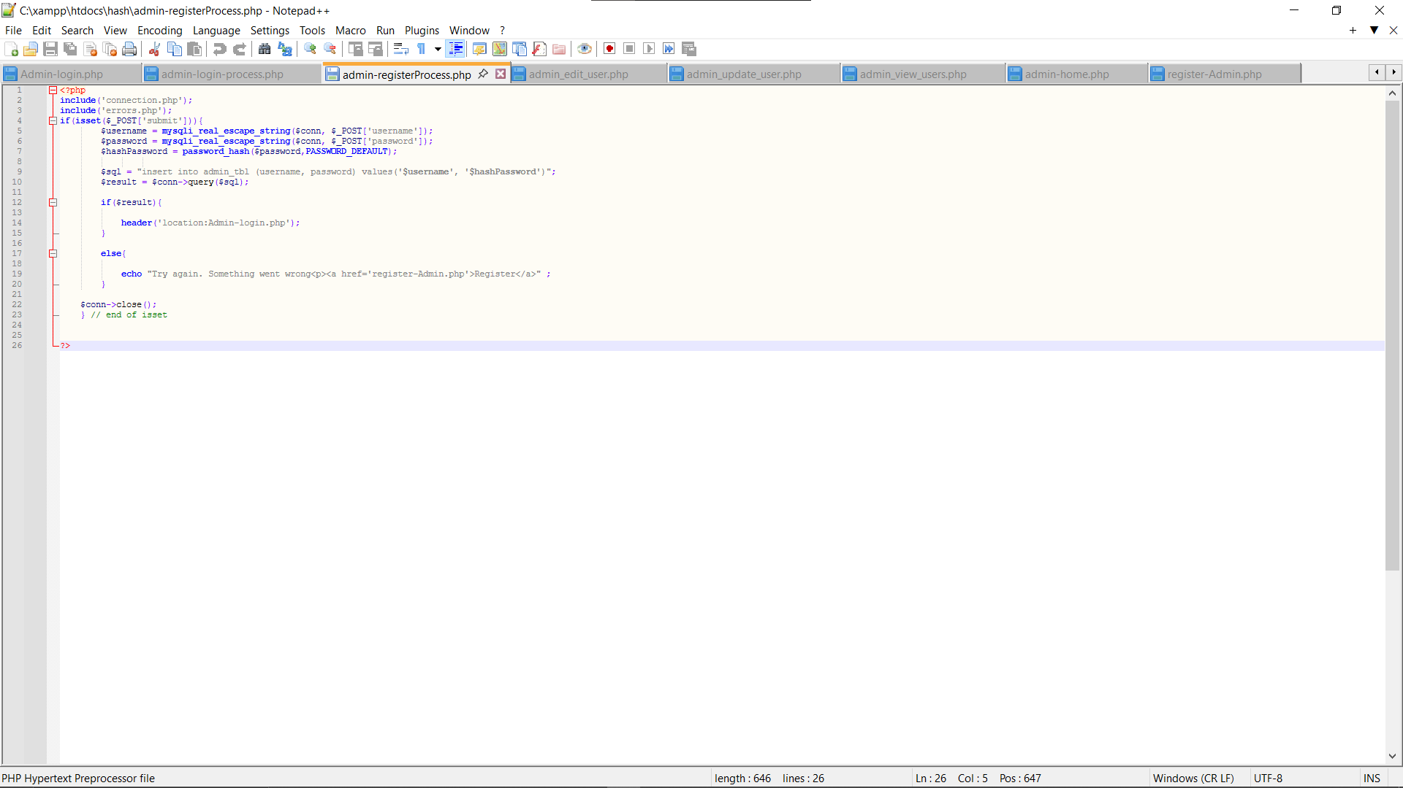
Admin Login Page
Register a New Admin
Admin Homepage
Notes:
These next two slides talk about options Admins have.
The first picture on the far-left is the admin login page and the two PHP codes used to allow the admin to enter their information onto this website, and then the second code is used to validate the admin before allowing them access to the account.
If a new admin needs to be registered, they will locate the administration login page and click the button register here to register a new admin.
This brings us to the middle screenshot, where you can register for an admin account.
The first code allows the new admin to enter their information and starts the process of connecting this information to the database
The second code finishes entering the admin into the database and redirects them to the admin homepage.
Leading Us to the Far-right picture of the Admin Homepage, which allows the admin to have full access to the entire webpage, including
log in
Log out
Edit data on the Database by using the Website
View the Course Schedule
Drop a Course
View or Search Available Courses
Register a course from the available course list and
be added to a waitlist if the class is already full.
deleting data and
deleting registered users from the database.
And so much more
NEXT PAGE:
Next are the last few of my Admin Pages I will add to my PowerPoint presentation, which will talk about the Admin view waitlist, the admin view registered students, and the edit of registered student information.

Slide 11
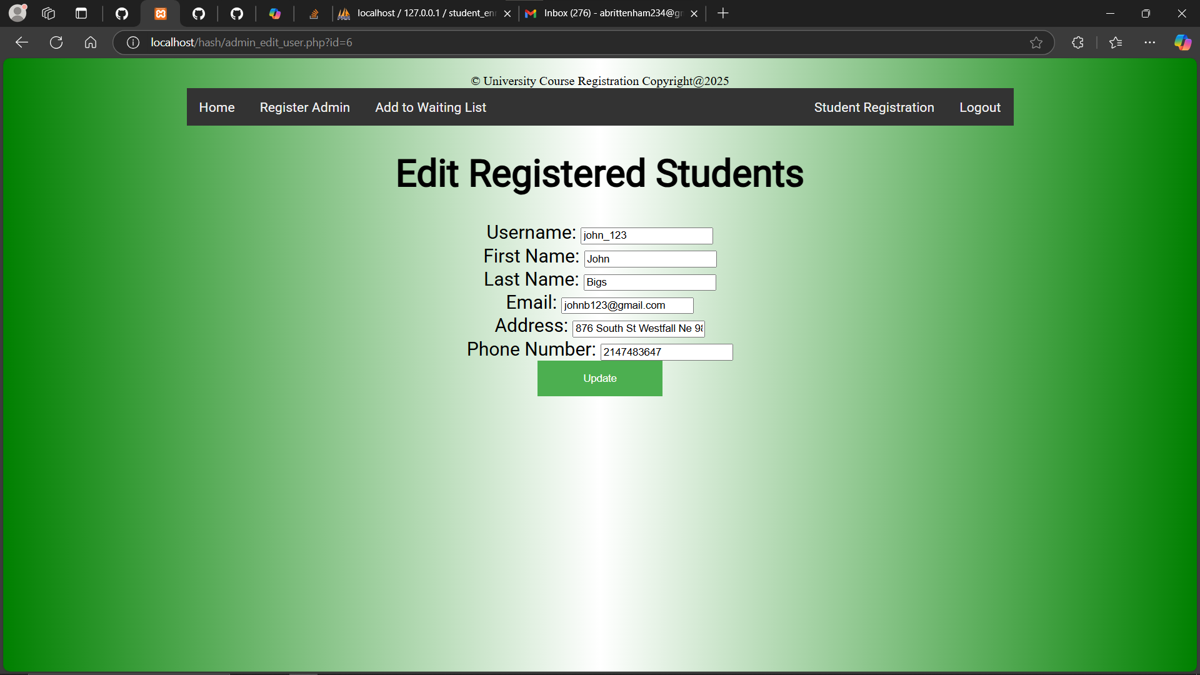
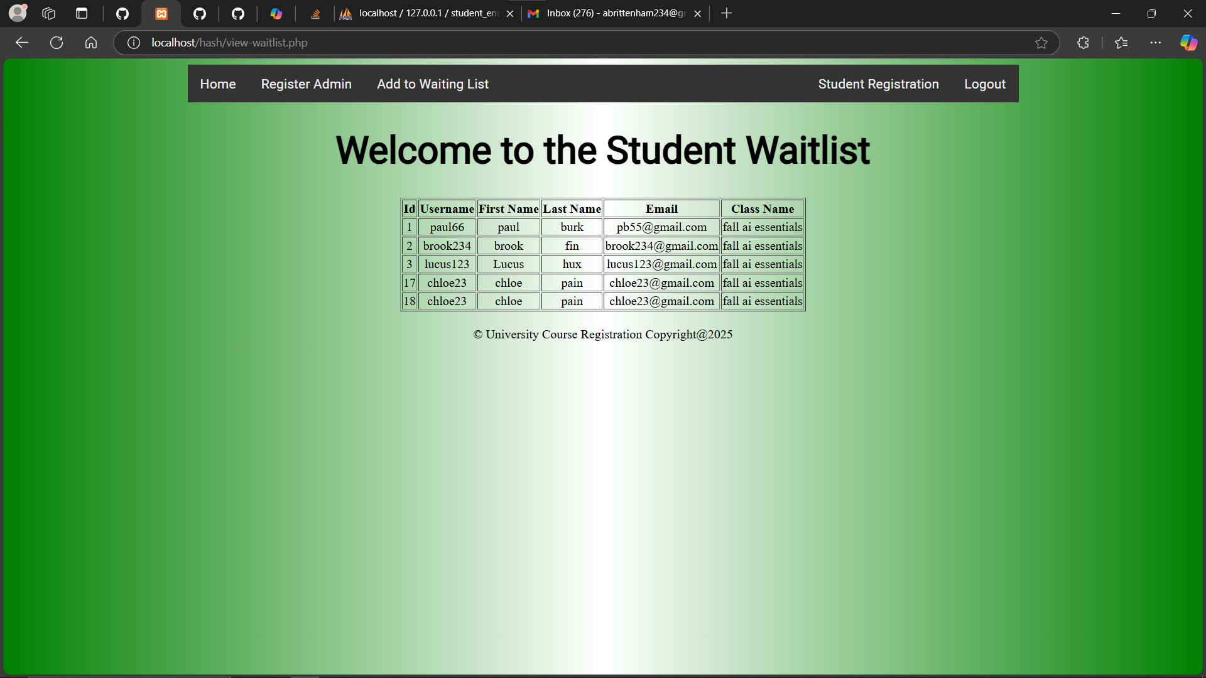
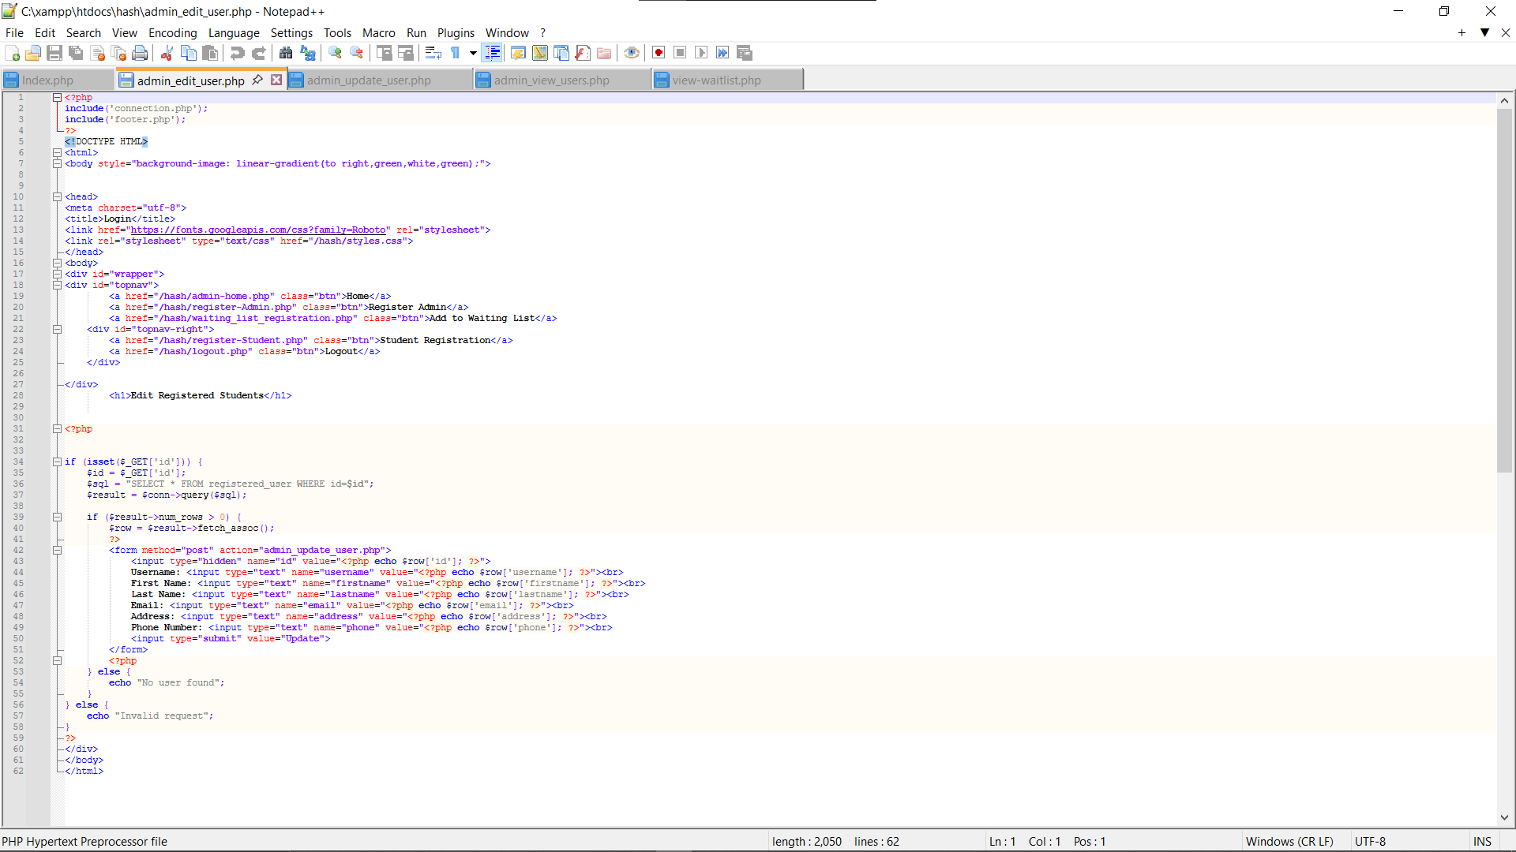
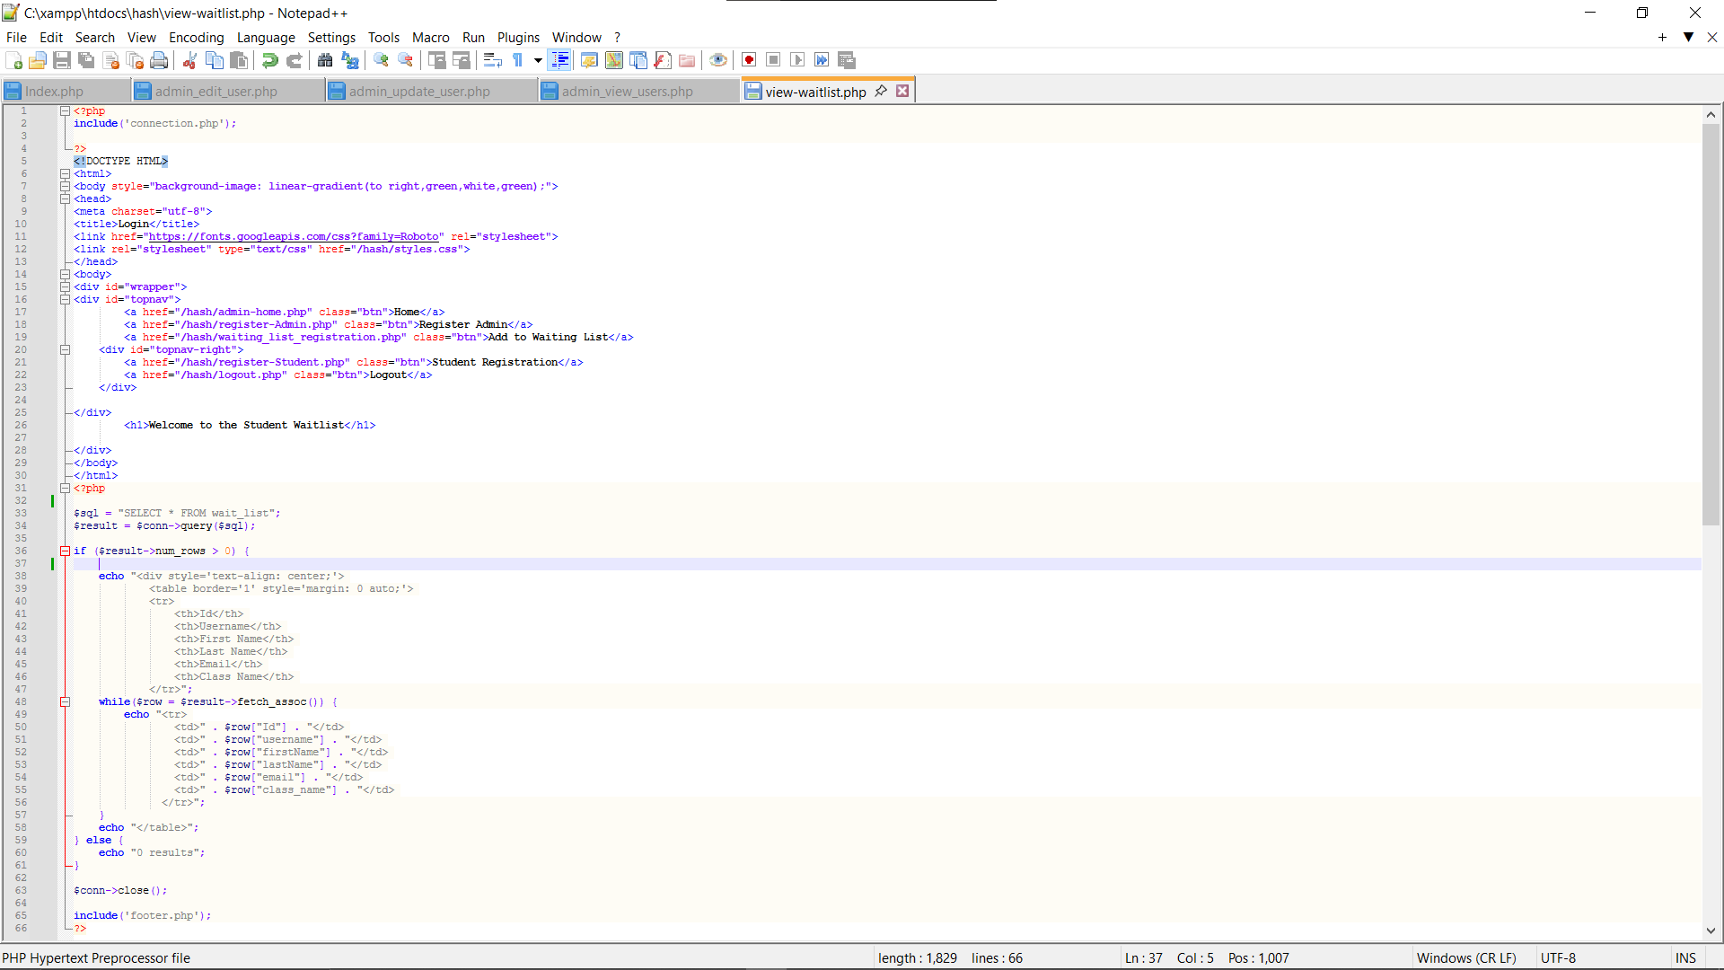
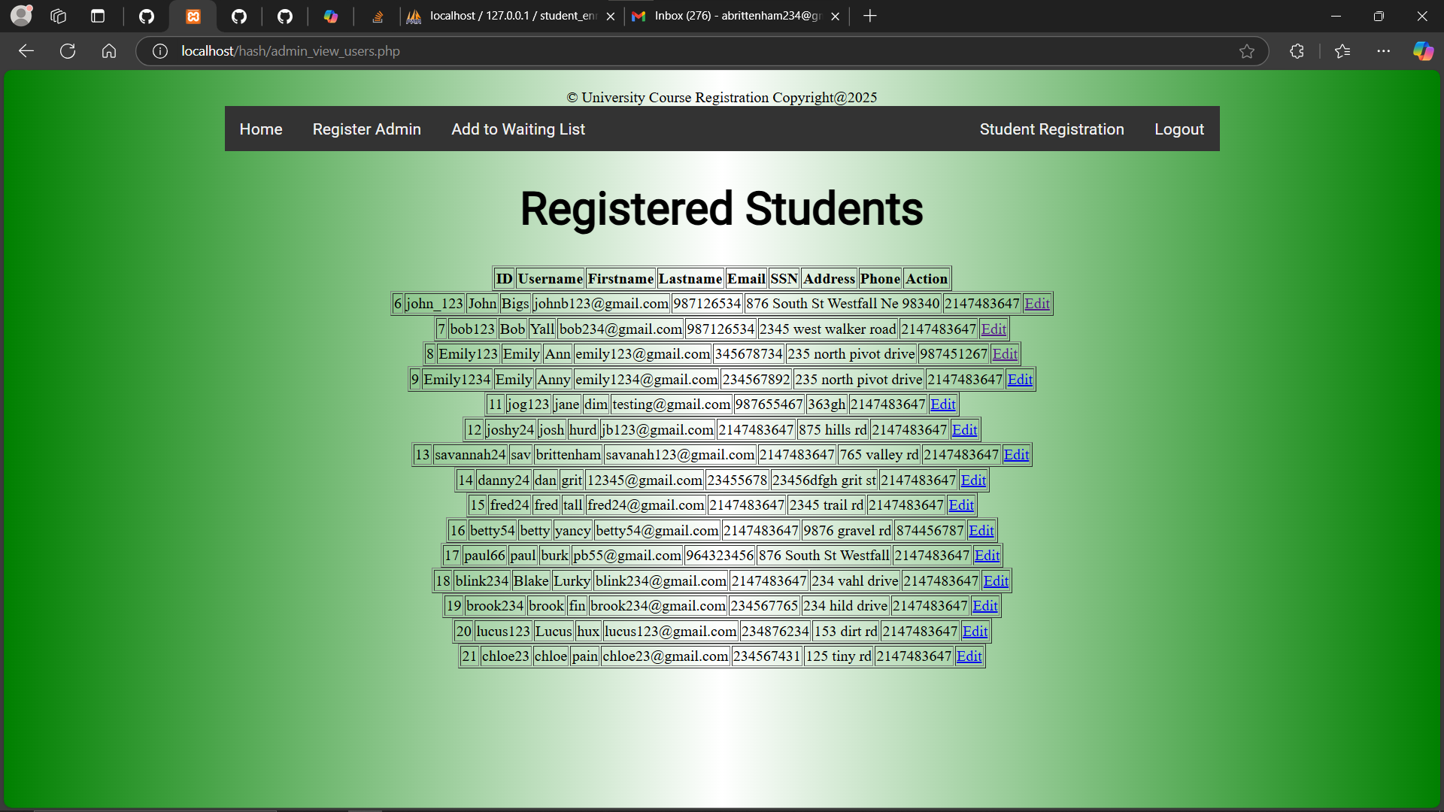
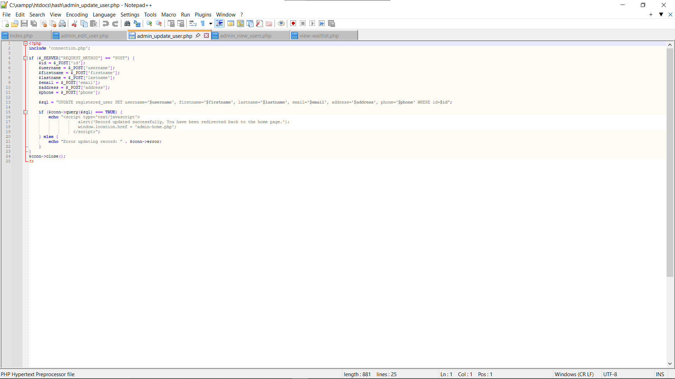
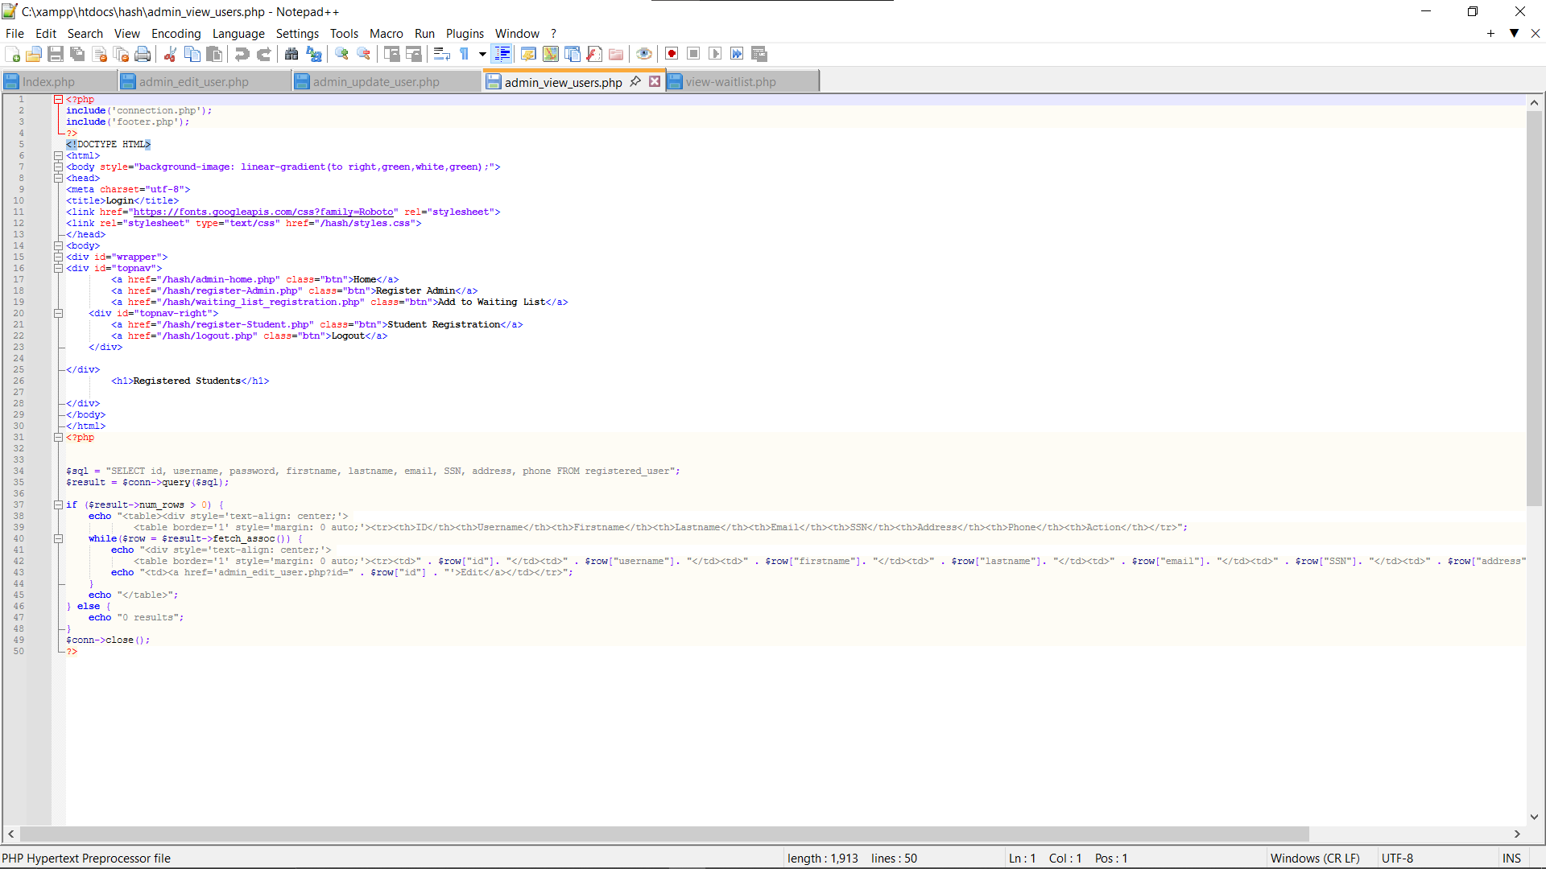

Admin View Waitlist
Admin Edit a Registered Student
Admin View Registered Students
Notes:
The Admin can view the student waitlist in the far-left picture.
This shows every student who is on a waitlist and the class for which they are on the waitlist.
Under this is the code used to pull from the tables to display the student waitlist on the admin website portal.
Just to the right of this picture is a screenshot of the admin view of all registered students who have enrolled as a student at the university.
Right under this picture is the PHP code used to pull this page resaved the table of registered students.
The last Admin screenshot I have here is the Admin Edit a Registered Student Page.
The 1st PHP code under this picture is this page that allows the admin to Edit any registered Students’ information in the database and start the process of transferring the data over to the database
The 2nd PHP code under this picture finishes transferring the data to the database, allowing for a pop-up.
Under both codes I have added another picture of that pop-up that shows the admin that the record updated successfully before redirecting them back to the admin home page.
NEXT PAGE:
Last but not least this next slide is my References page

Slide 12
References
Acceptance Testing-Software Testing (12 Jun 2024) https://www.geeksforgeeks.org/acceptance-testing-software-testing/
Component Software Testing (14 Aug 2019) https://www.geeksforgeeks.org/component-software-testing/
Incremental Testing in Software Testing (22 Sep 2023) https://www.geeksforgeeks.org/incremental-testing-in-software-testing/.
Kobylinski, K., & McLeod, R. D. (1997). Object-oriented top-down software design process. IEEE WESCANEX 97 Communications, Power and Computing. Conference Proceedings, WESCANEX 97: Communications, Power and Computing. Conference Proceedings., IEEE, WESCANEX 97 Communications Power and Computing, 76–81. https://doi.org/10.1109/WESCAN.1997.627116
Mikoluk, K. (2013, September 18). XAMPP tutorial: How to use XAMPP to run your own web serverLinks to an external site.. Udemy. https://blog.udemy.com/xampp-tutorial.
Reza, H., & Grant, E. (2007). A method to test concurrent systems using architectural specification. Journal of Supercomputing, 39(3), 347–357. https://doi.org/10.1007/s11227-006-0017-0
System Testing-Software Engineering (26 Sep 2024) https://www.geeksforgeeks.org/system-testing/
Tsui, F., Karam, O., & Bernal, B. (2018). Essentials of Software Engineering (4th ed..). Jones & Bartlett Learning. https://platform.virdocs.com/read/2348054/14/#/4/2[ch09]/4/2/4/4/2
Notes:
These are just some references I used throughout this class and Project!
Thank you for Listening and following my presentation on my Final Software Project.

